Slide 2
Strange Pentaquarks
Michał Praszałowicz
M. Smoluchowski Inst. of Physics
Jegellonian University,
Kraków, Poland

Slide 3

Strange Pentaquarks
Michał Praszałowicz
M. Smoluchowski Inst. of Physics
Jegellonian University,
Kraków, Poland

Slide 4
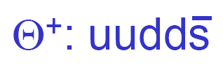
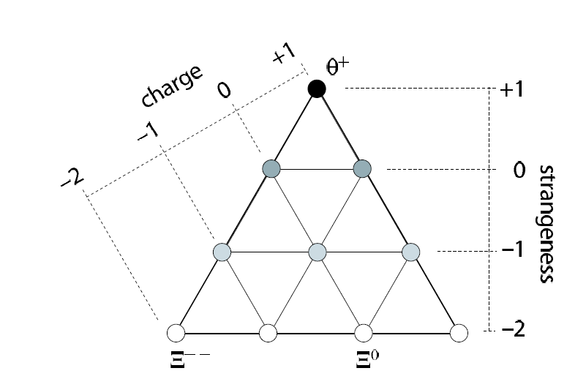
~1540

Slide 5
Time dependent experimental status of Θ⁺
γ + d (n ) reactions
γ + p → p K_{s}⁰
γ + p → n K⁺ K⁻ π⁺
K + (N) → p K_{s}⁰
lepton + D, A → p K_{s}⁰
p + A → pK_{s}⁰ + X
p + p → pK_{s}⁰ + Σ⁺
Other Θ⁺ Upper Limits
LEPS-C
CLAS-d1
LEPS-d
LEPS-d2
CLAS-d2
SAPHIR
CLAS g11
CLAS-p
DIANA
DIANA
BELLE
Hermes
ZEUS
νBC
BaBar
SVD2
JINR
SPHINX
HyperCP
SVD2
ALEPH, Z
COSY-TOF
COSY-TOF
HERA-B
BES J,Ψ
CDF
FOCUS
WA89
2002 2003 2004 2005 2006 2007
: Positive result
: Negative result

Slide 6
Ideal experiment

Slide 7



Formation cross section
Breit-Wigner cross-section (GM + MP)
K⁺
1/2
n
0
1/2
1/2 1/2

Slide 8
Time dependent experimental status of Θ⁺
γ + d (n ) reactions
γ + p → p K_{s}⁰
γ + p → n K⁺ K⁻ π⁺
K + (N) → p K_{s}⁰
lepton + D, A → p K_{s}⁰
p + A → pK_{s}⁰ + X
p + p → pK_{s}⁰ + Σ⁺
Other Θ⁺ Upper Limits
LEPS-C
CLAS-d1
LEPS-d
LEPS-d2
CLAS-d2
SAPHIR
CLAS g11
CLAS-p
DIANA
DIANA
BELLE
Hermes
ZEUS
νBC
BaBar
SVD2
JINR
SPHINX
HyperCP
SVD2
ALEPH, Z
COSY-TOF
COSY-TOF
HERA-B
BES J,Ψ
CDF
FOCUS
WA89
2002 2003 2004 2005 2006 2007
: Positive result
: Negative result

Slide 9
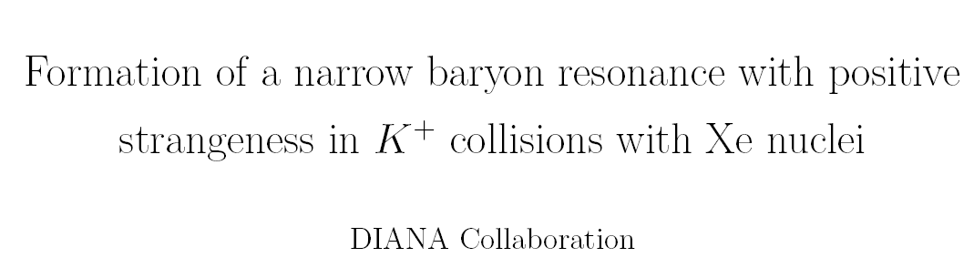
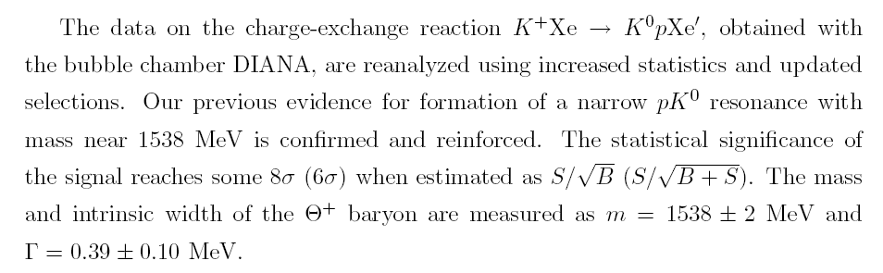

Slide 10
BELLE: secondary kaon beam
from D decays interacting
with silicon in vertex detecor :
 < 0.64 MeV
R. Mizuk, Europhysics 2005, Lisbon. July 2005

Slide 11
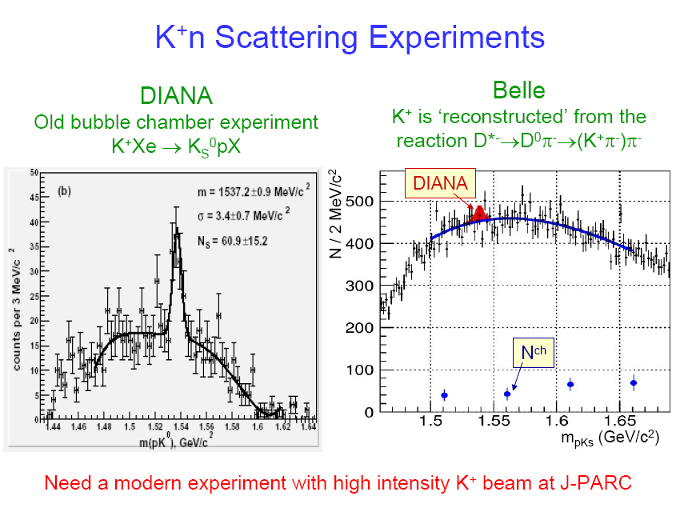

Slide 12
Time dependent experimental status of Θ⁺
γ + d (n ) reactions
γ + p → p K_{s}⁰
γ + p → n K⁺ K⁻ π⁺
K + (N) → p K_{s}⁰
lepton + D, A → p K_{s}⁰
p + A → pK_{s}⁰ + X
p + p → pK_{s}⁰ + Σ⁺
Other Θ⁺ Upper Limits
LEPS-C
CLAS-d1
LEPS-d
LEPS-d2
CLAS-d2
SAPHIR
CLAS g11
CLAS-p
DIANA
DIANA
BELLE
Hermes
ZEUS
νBC
BaBar
SVD2
JINR
SPHINX
HyperCP
SVD2
ALEPH, Z
COSY-TOF
COSY-TOF
HERA-B
BES J,Ψ
CDF
FOCUS
WA89
2002 2003 2004 2005 2006 2007
positive result from LEPS (Japan) remains
: Positive result
: Negative result

Slide 13
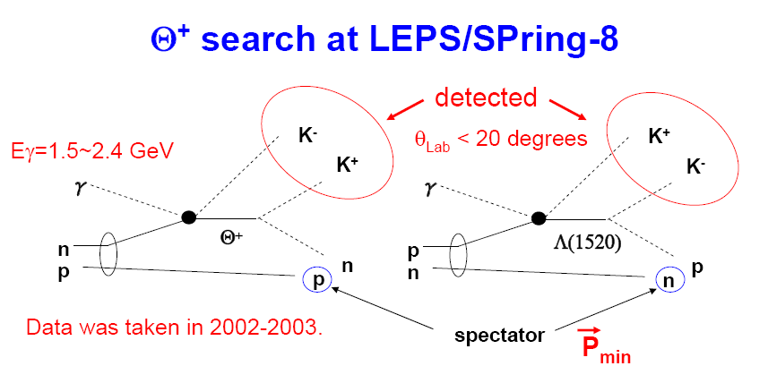
T. Nakano (Osaka)
Evidence of the Theta+ in the gamma d ---> K+ K- pn reaction.
By LEPS Collaboration (T. Nakano et al.).
Published in Phys.Rev.C79:025210,2009.
e-Print: arXiv:0812.1035

Slide 14
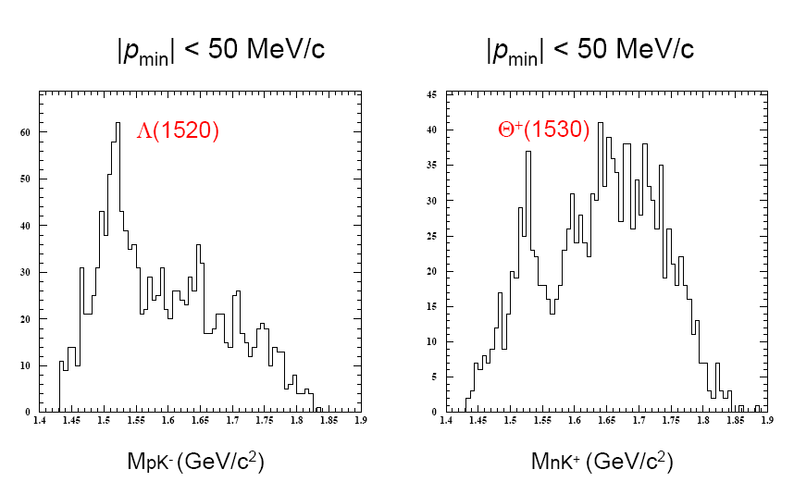
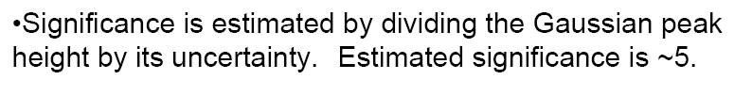

Slide 15
MM_{γΚ−} (GeV)
T. Hotta, Acta Phys. Pol. B36, 2173

Slide 16
Time dependent experimental status of Θ⁺
γ + d (n ) reactions
γ + p → p K_{s}⁰
γ + p → n K⁺ K⁻ π⁺
K + (N) → p K_{s}⁰
lepton + D, A → p K_{s}⁰
p + A → pK_{s}⁰ + X
p + p → pK_{s}⁰ + Σ⁺
Other Θ⁺ Upper Limits
LEPS-C
X
CLAS-d1
LEPS-d
LEPS-d2
CLAS-d2
SAPHIR
CLAS g11
CLAS-p
DIANA
DIANA
BELLE
Hermes
ZEUS
νBC
BaBar
SVD2
JINR
SPHINX
HyperCP
SVD2
ALEPH, Z
COSY-TOF
COSY-TOF
HERA-B
BES J,Ψ
CDF
FOCUS
WA89
2002 2003 2004 2005 2006 2007
negative results from CLAS high statistics d run
contradicts previous CLAS analysis
and contradicts LEPS
: Positive result
: Negative result

Slide 17
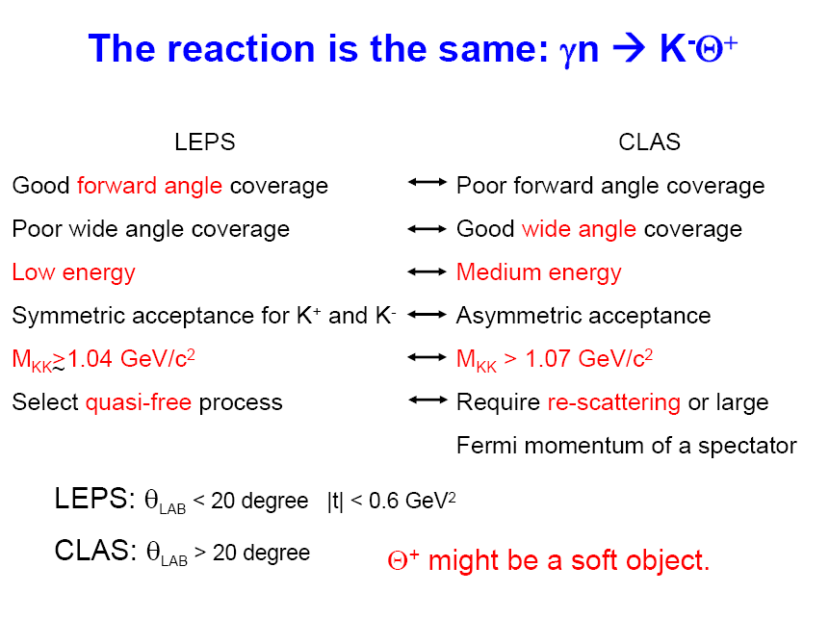
Comparison of LEPS and CLAS

Slide 18
Comparison of LEPS and CLAS

Slide 19
Time dependent experimental status of Θ⁺
γ + d (n ) reactions
γ + p → p K_{s}⁰
γ + p → n K⁺ K⁻ π⁺
K + (N) → p K_{s}⁰
lepton + D, A → p K_{s}⁰
p + A → pK_{s}⁰ + X
p + p → pK_{s}⁰ + Σ⁺
Other Θ⁺ Upper Limits
LEPS-C
X
CLAS-d1
LEPS-d
LEPS-d2
CLAS-d2
X
SAPHIR
CLAS g11
CLAS-p
DIANA
DIANA
BELLE
Hermes
ZEUS
νBC
BaBar
SVD2
JINR
SPHINX
HyperCP
SVD2
ALEPH, Z
COSY-TOF
COSY-TOF
HERA-B
BES J,Ψ
CDF
FOCUS
WA89
2002 2003 2004 2005 2006 2007
negative results from CLAS high statistics run
contradiced previous experiments
: Positive result
: Negative result

Slide 20
t-channel production of Θ⁺
K⁰
K⁻
K*
K*⁺
p
Θ⁺
n
Θ⁺
K⁰
K⁻
K⁰
K⁺
p
Θ⁺
n
Θ⁺

Slide 21
t-channel production of Θ⁺
K⁰
K⁻
K*
K*⁺
p
Θ⁺
n
Θ⁺
?
?
K⁰
K⁻
K⁰
K⁺
p
Θ⁺
n
Θ⁺
known

Slide 22
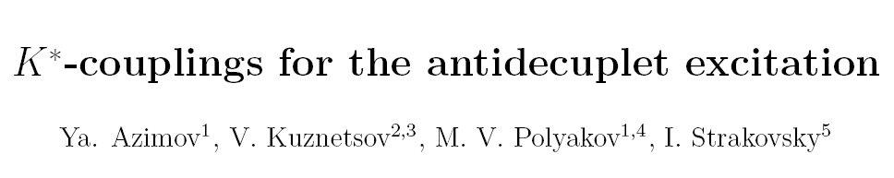
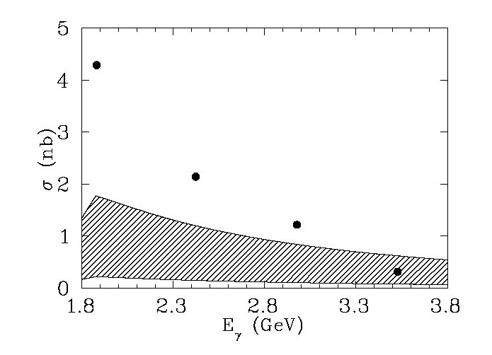
CLAS estimate
limits corresponding
to the range
of K* couplings

Slide 23
Main assumption
Theta+ exists
with M ~ 1540 MeV
and total width ~ 1 MeV
What about other members of antidecuplet?

Slide 24
~1540
1647 ?
1754 ?
NA 49
NA 61
1861 ?

Slide 25
~1540

Slide 26
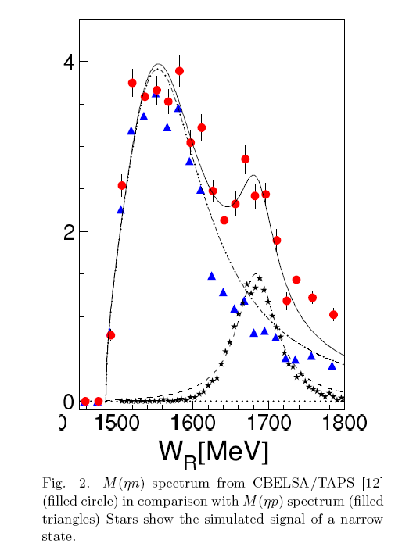
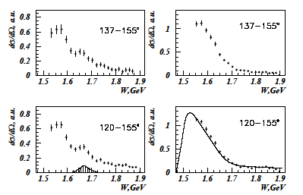

Is there a narrow resonance in nucleon excitation?
GRAAL:
ηn measurement: quasi-free kinematics
ηn measurement in D(γ,ηn)p
Kunznetsov et al. preprint (05)
ηn
ηp

Slide 27
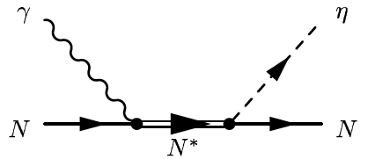
eta photoproduction on nucleon

Slide 28
Hints from PWA
(Arndt, Azimov, Polyakov, Workman)
STAR (Kabana....)

Slide 29

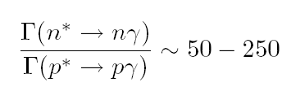
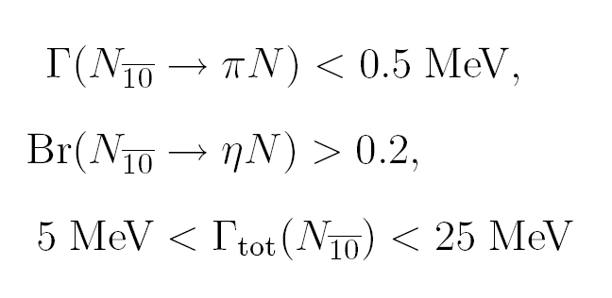
Properties of N*(1685)
Very good candidate for
nucleon-like member of
antidecuplet
Decay to pion
is suppressed
Г > 1 MeV
η photoprodution depends on: Br x μ_{transition}²
and is therefore dependent on model calculation of μ_{transition}

Slide 30
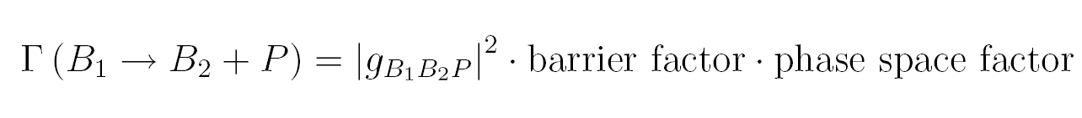
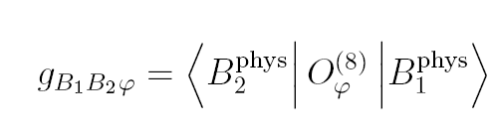
Decay widths
SU(3) relations
= reduced matrix element × SU(3) Clebsch

Slide 31

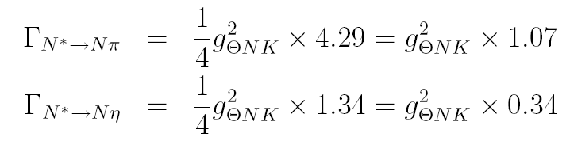
Decays of N*(1685) in SU(3) limit
Problem:
in SU(3) limit decay to pion is 3 times larger than to eta

Slide 32
Solution: mixing

Slide 33
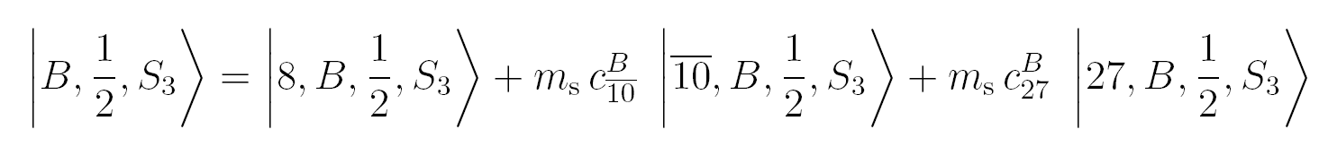
SU(3) flavor symmetry
Some trivial facts on SU(3) breaking
Broken SU(3)
Exact SU(3)
all masses equal
GMO mass formulae

Slide 34


SU(3) flavor symmetry
Some trivial facts on SU(3) breaking
Broken SU(3)
Exact SU(3)
all masses equal
GMO mass formulae

Slide 35
Mixing
mixing with ground state octet α
the same for N and Σ

Slide 36



Decay of Theta⁺
Θ⁺ → K N

Slide 37
Decay of Theta⁺
Θ⁺ → K N
Normal situation:
large small large
CANCELLATION !
Antidecuplet: small small large

Slide 38
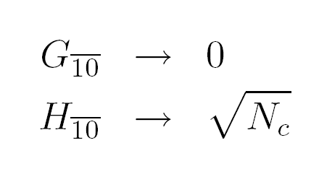
Chiral Quark Soliton Model
In large N_{c} non-relativistic limit:

Slide 39
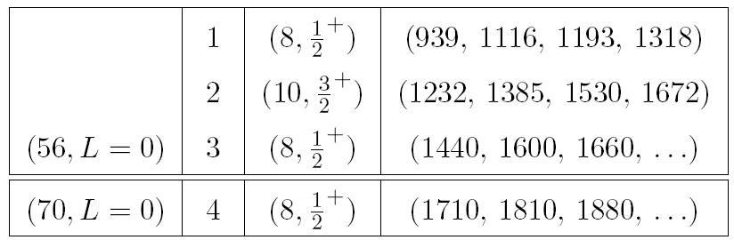
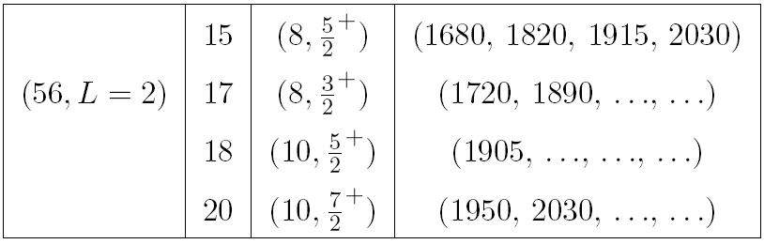
Low lying J⁺ baryon multiplets

Slide 40
Mixing with „Roper ocet”
mixing with „Roper octet” φ
the same for N and Σ

Slide 41
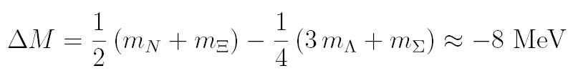

„Roper octet”
GMO mass formula
works well
improvement possible
through additional
mixing
1440****
1600 ***, 1660***
1690*** (spin=?,P=?)

Slide 42
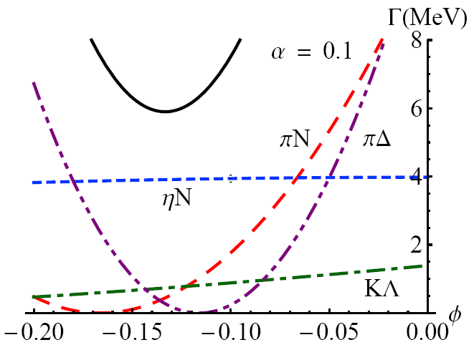
Decays of N₁₀(1685) mixing with the Roper octet

Slide 43
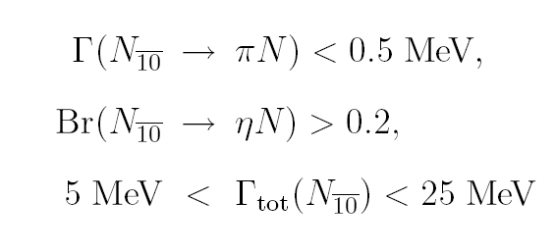
Constraining mixing angles

Slide 44
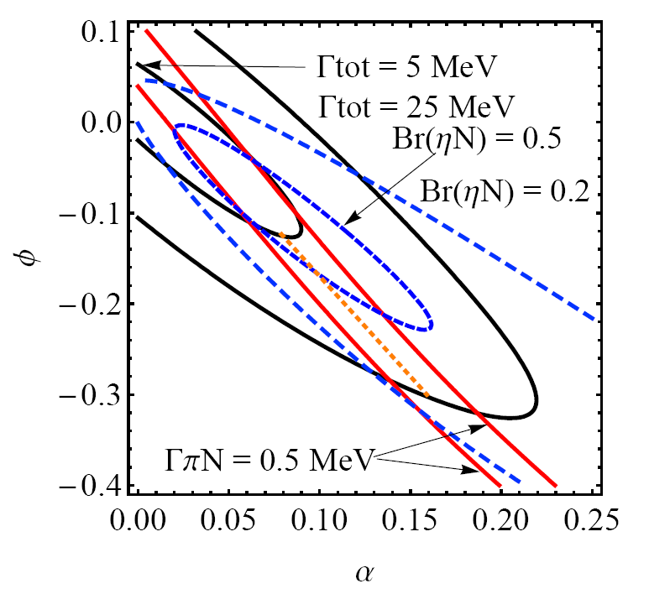

Slide 45
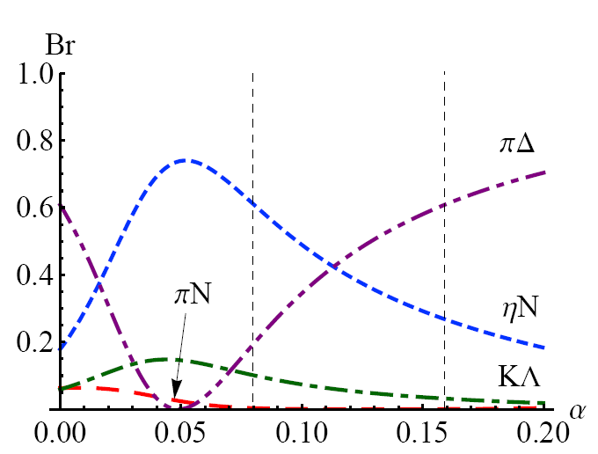
Decays of N₁₀(1685) branching rats.along the orange line

Slide 46
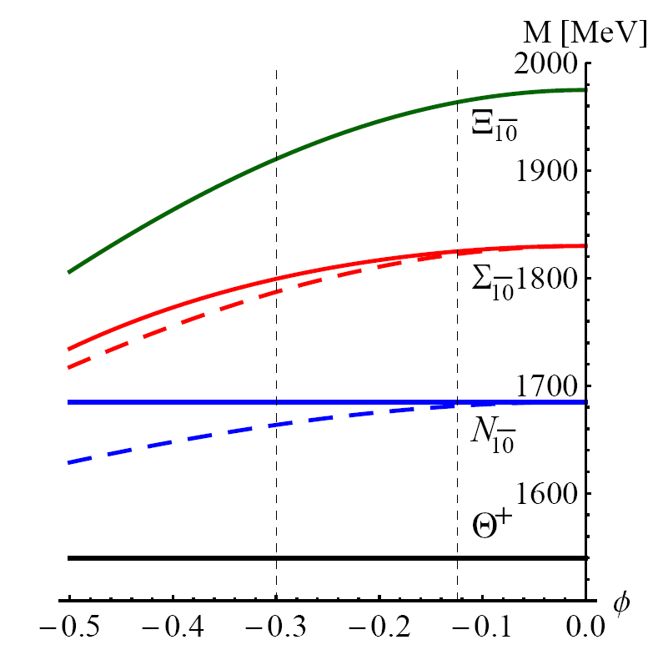
Properties of Σ₁₀ and Ξ₁₀
dashed = GMO

Slide 47
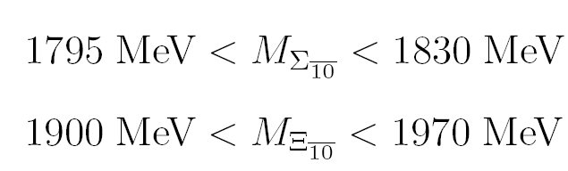
Properties of Σ₁₀ and Ξ₁₀
NA 49 (1860) excluded

Slide 48
~1540
1647 ?
1685
1754 ?
~1815
1861 ?
~1935

Slide 49
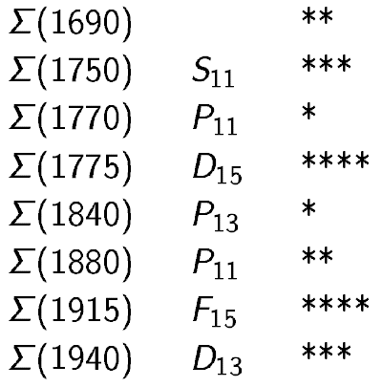

Slide 50
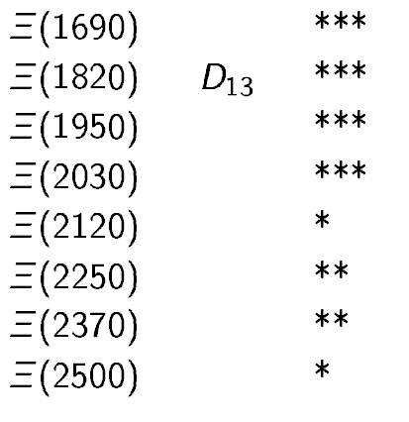

Slide 51
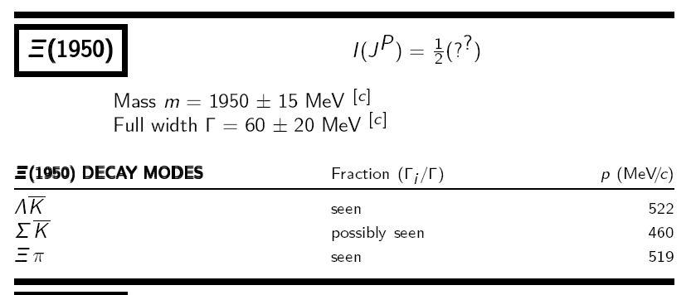

Slide 52
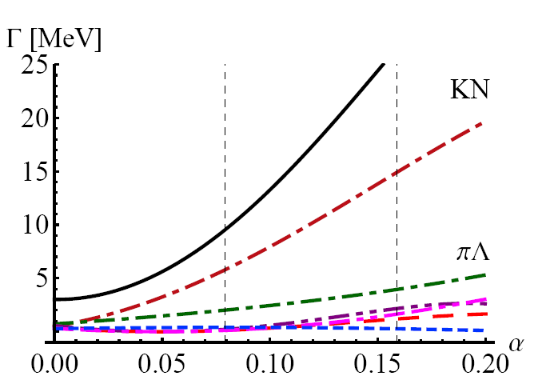
Properties of Σ₁₀

Slide 53
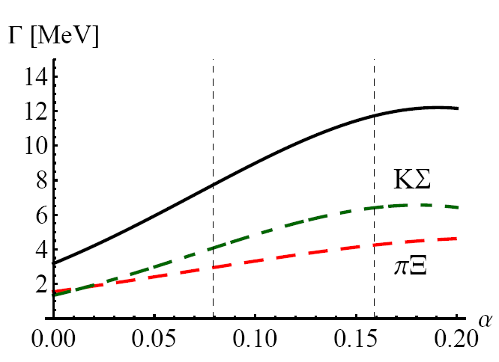
Properties of Ξ₁₀

Slide 54
Summary
We still need a dedicated K⁺N formation experiment to
decide existence of Theta+
If Theta+ exists and has total width ~ 1 MeV:
new narrow resonance N(1685) can be interpreted
as a member of antidecuplet only if mixing is included
we propose to consider mixing of antidecuplet with Roper and
ground state octets (Roper does not decay to eta N)
SU(3) forbidden decay of N(1685) to πΔ is 20 – 65 %
fixing mixing angles from N(1685) we calculate
masses and partial widths of antidecuplet Sigma
M ~ 1815 MeV, decays: KN 60% and πΛ 20%, Г~10-30 MeV
antidecuplet Xi ~1935 (contradicts NA 49), Г~10 MeV

