Slide 1
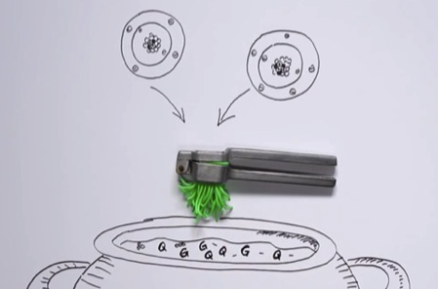

Slide 3
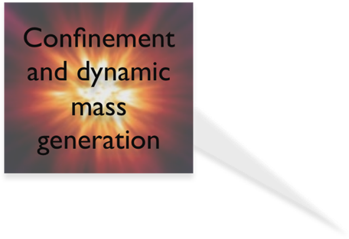
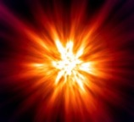
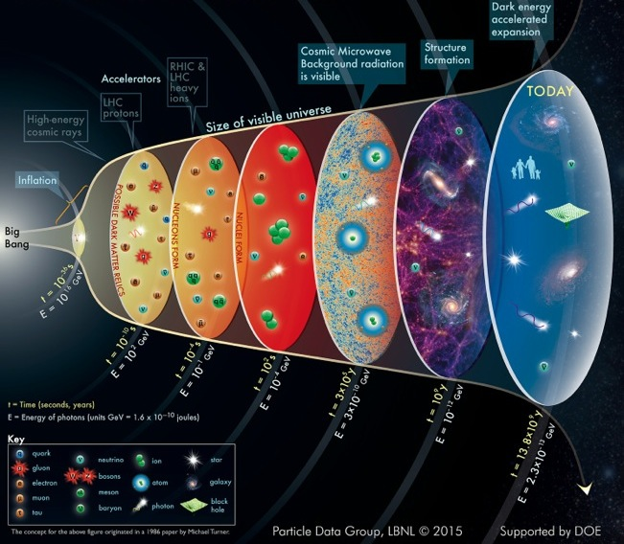
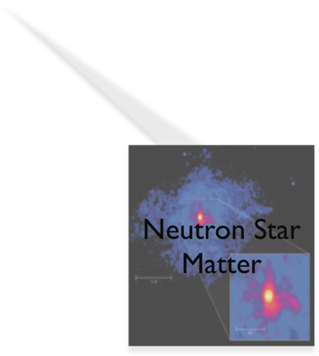
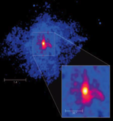
Confinement and dynamic mass generation
Neutron Star Matter

Slide 5
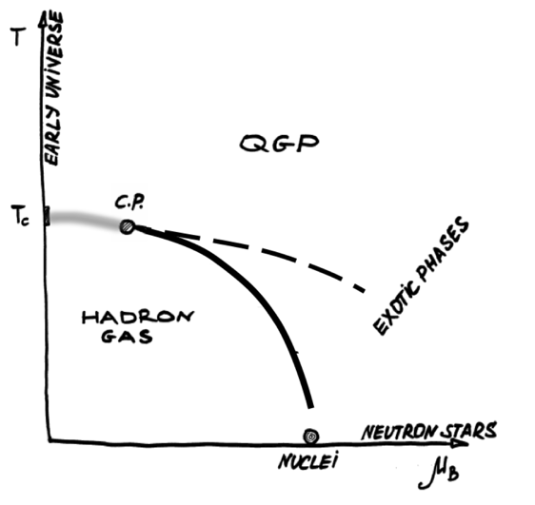

Slide 6
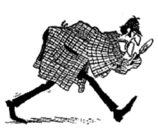

Slide 7
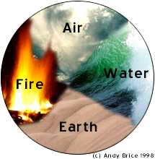
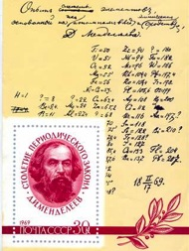
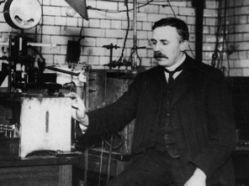
Anaximenes concept of elements says that air is the first principle of all things. Air turns to wind, wind to cloud, cloud to water, water to earth. Very elegant, however, wrong!
Around 1900, people thought of atoms as permeable balls with bits of electric charge bouncing around inside.
D. Mendeleev, 1879: quantitative ordering of the elements. This indicated that atoms were made up of simpler building blocks.
In 1911 E. Rutherford discovered the nucleus → atoms have a tiny but dense, positively charged nucleus and a cloud of negative electrons (e⁻). The observed angular distribution of α-particles was in agreement with the assumption of pure electromagnetic scattering off an object with: M >> M_{α} and R < 3 × 10 ^{–14} m

Slide 8
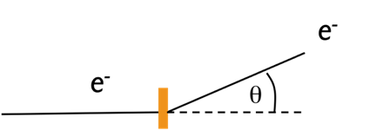

Slide 9
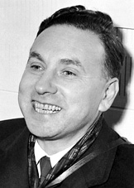
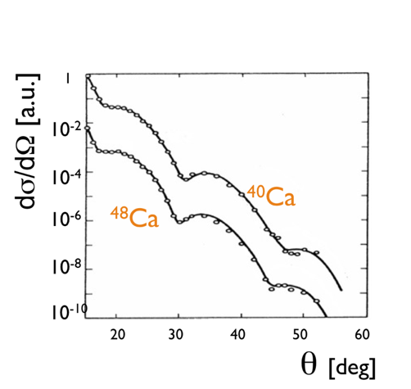
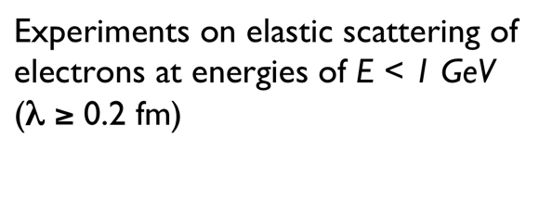
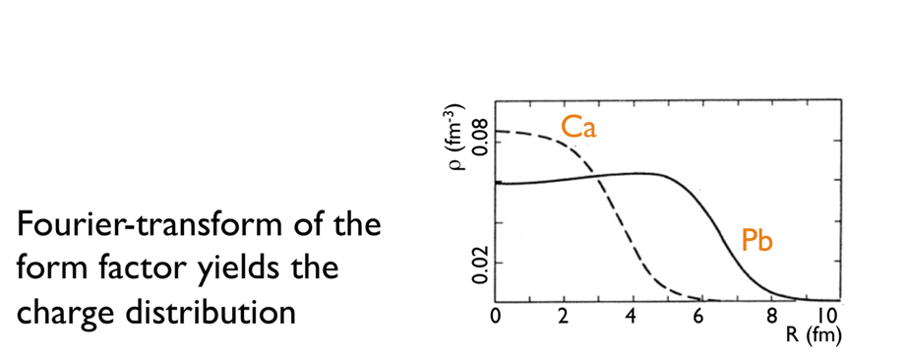
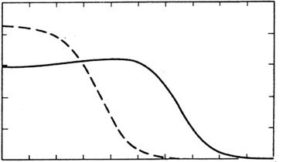
ρ (fm⁻³)
0.08
Ca
Fourier-transform of the form factor yields the charge distribution
0.02
Pb
0 2 4 6 8 10
R (fm)

Slide 10
For normal shoes, the road is flat
High-heels find unevenness

Slide 11
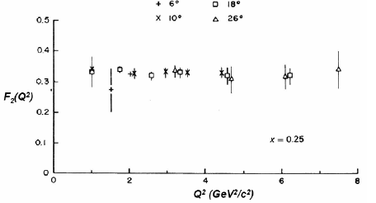

Slide 12
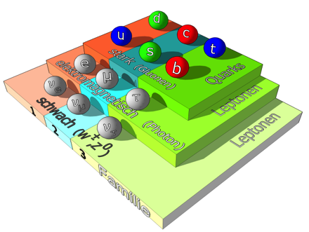
Very successful theory, but with outstanding puzzles

Slide 13
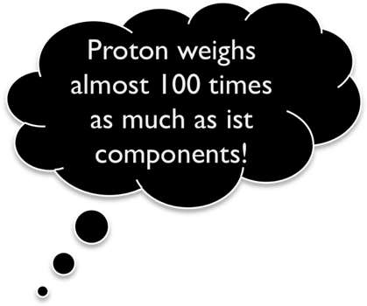
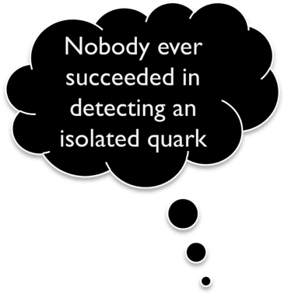
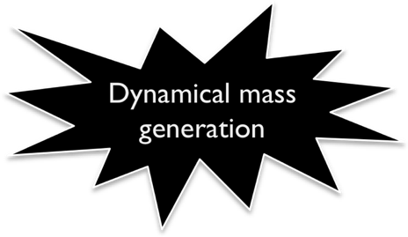
Proton weighs almost 100 times as much as ist components!
Nobody ever succeeded in detecting an isolated quark
Dynamical mass generation
Quark confinement!

Slide 14
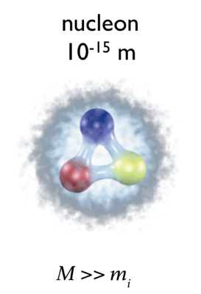
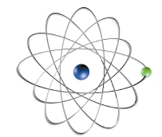
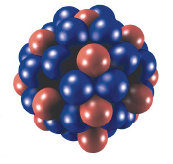
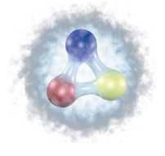
nucleon 10⁻¹⁵ m

Slide 15
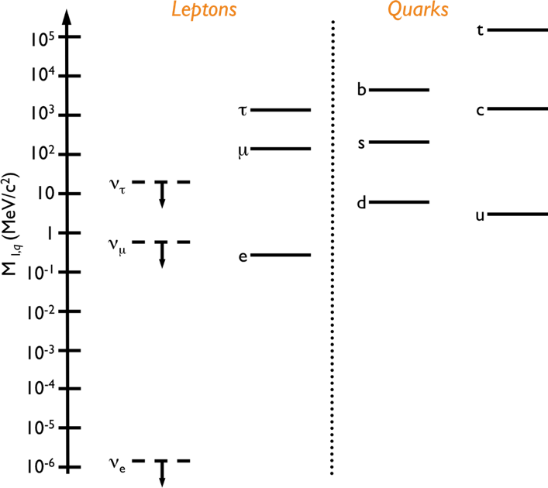
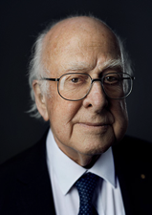
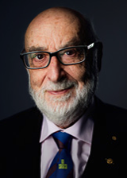

Slide 16
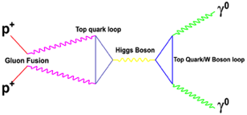
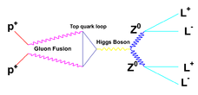
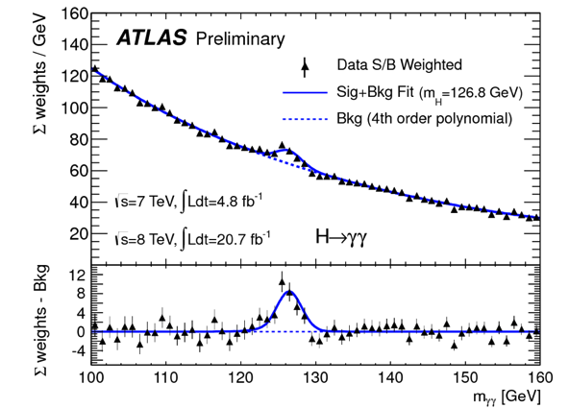
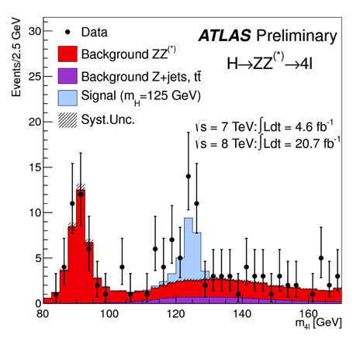

Slide 17
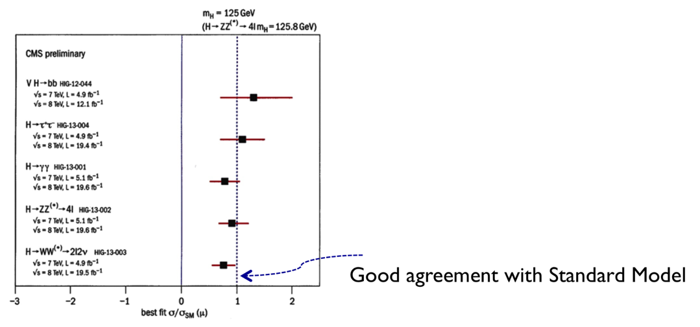
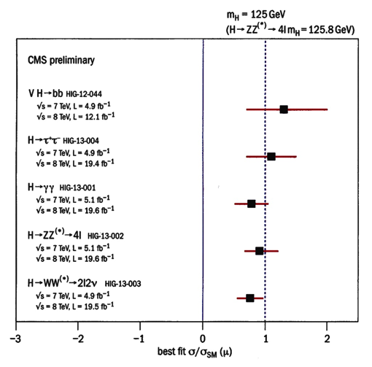
Do branching ratios for different final states agree with expectations within the Standard Model ?
Good agreement with Standard Model

Slide 18
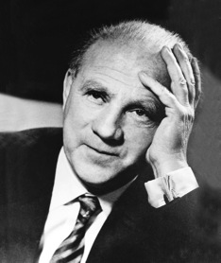
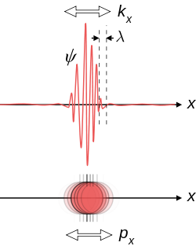
Quarks are confined within the volume of the nucleon
→ “Heisenberg” motion of quarks:
W. Heisenberg
1927
The interaction among quarks has to become so strong that it overcomes their quantum mechanical resistance to localization
Key dynamical phenomenon: running of the QCD coupling strength
F. Wilczek

Slide 19
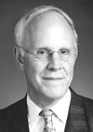
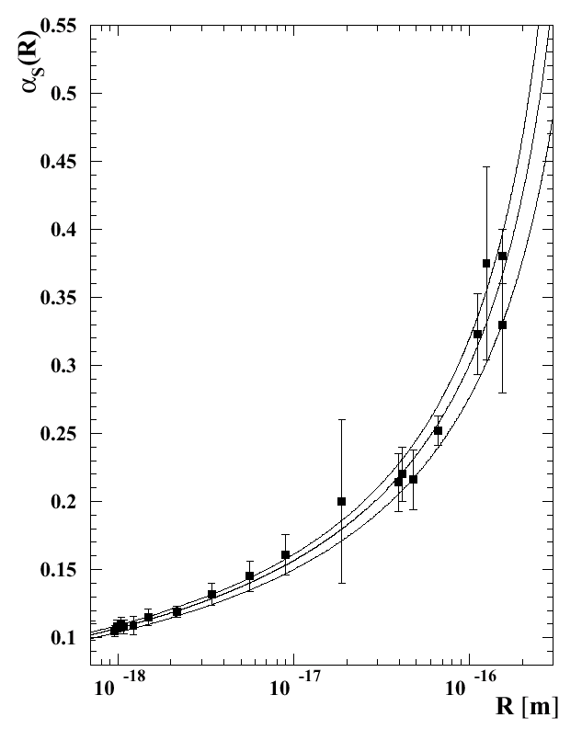
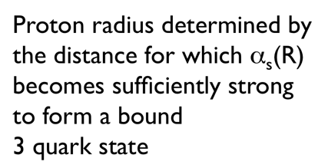

Slide 20
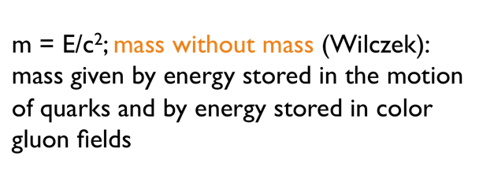
m = E/c²; mass without mass (Wilczek):
mass given by energy stored in the motion of quarks and by energy stored in color gluon fields

Slide 21
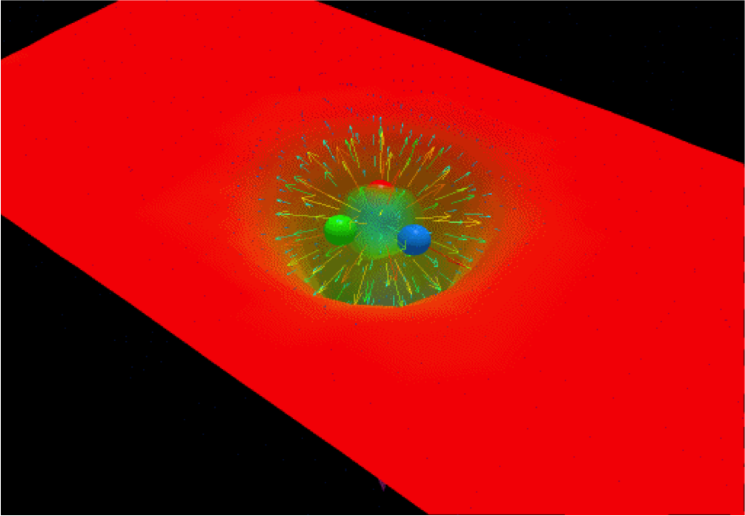

Slide 22
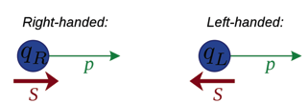
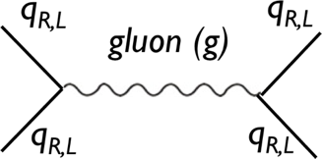
QCD Lagrangian for m_{q}=0
is invariant under the SU(3)_{R}SU(3)_{L} transformations:
quark-gluon coupling
gluon-gluon coupling

Slide 23
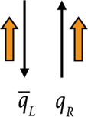
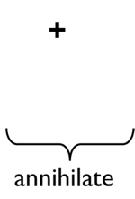
+
=
annihilate
is an order parameter of chiral symmetry

Slide 24
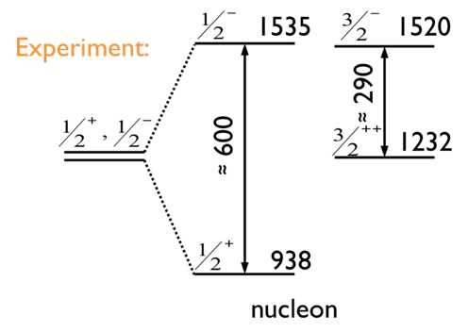
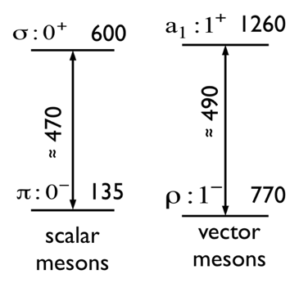
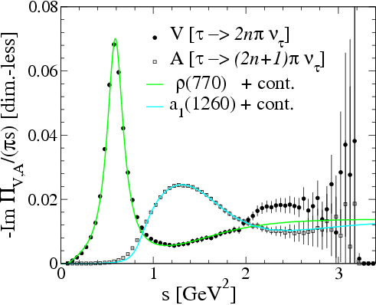
1260
Axial-/Vector Correlators
1535
1520
600
Experiment:
≈ 290
≈ 490
≈ 600
1232
≈ 470
135
770
938
scalar mesons
vector mesons
nucleon
“Chiral partners” split: ΔM ≈ 0.5GeV
Ch. symm. is broken in hadronic sector

Slide 25
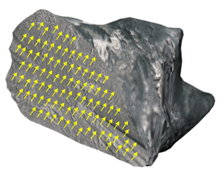
magnetisation M
ferro magnetic
para magnetic
T_{Curie}
temperature T

Slide 30
q
q
q
q
q
q
q
q
q
q
q
q
q
q
q
q
q
q
q
q
q
q
q
q
But, chiral condensate is not an experimental observable!

Slide 35
In heavy-ion collisions
Source strength: dependence on T, μ_{B}, μ_{p} , medium effects, …
System evolution: V(τ), T(τ), μ_{B}(τ), transverse expansion, …
Non-thermal sources: Drell-Yan, open-charm, hadron decays, …

Slide 38
thermal emission
τ_{FB} ~ 10fm/c
after freezeout
τ_{V} ~ 1/Γ_{V}^{tot}

Slide 39
M. Post, S. Leupold, U. Mosel
NPA 741(2004) 84
R. Rapp and J. Wambach, Eur.Phys.J. A6 (1999)
Broadening of spectral function due to coupling to nucleon resonances

Slide 41
Experimental test!

Slide 44
High multiplicity effects
Is Nucleus+Nucleus > N * (Nukelon+Nukleon)?
…
N times
…

Slide 45
Heavy-ion collisions: A+A
Elementary reactions: γ, p, π-beams
advantage:
sizable effects due to high densities and temperatures (regeneration of mesons)
advantage:
well controlled conditions: important for theoretical interpretation no time dependence of baryon density: ρ_{B} ≠ρ_{B}(t);T=0;
disadvantage:
any signal represents an integration over the full space-time history of the heavy-ion collision with strong variations in densities and temperatures
disadvantage:
small medium effects since
ρ ≤ ρ₀ and T=0
Goal (in both approaches):
Test concepts for hadron mass generation by comparing predictions based on these concepts with experimental observations how hadron properties are changed in a strongly interacting environment.

