Slide 1
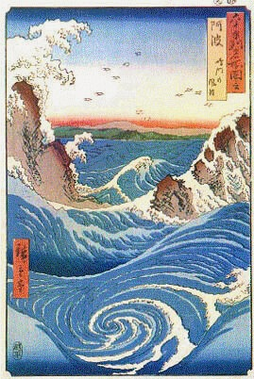
The problem of thermalization
in Heavy Ion collisions
Raju Venugopalan
Brookhaven National Laboratory / Heidelberg
NP Colloquium, Frankfurt, December 2015

Slide 2
Talk outline
Turbulent thermalization from first principles: from Color Glass Condensate to
perfect fluid
Discovery of a remarkable universality
What is the tiniest and most ephemeral possible droplet of quark-gluon matter?
Off- equilibrium sphaleron transitions in the Glasma

Slide 3
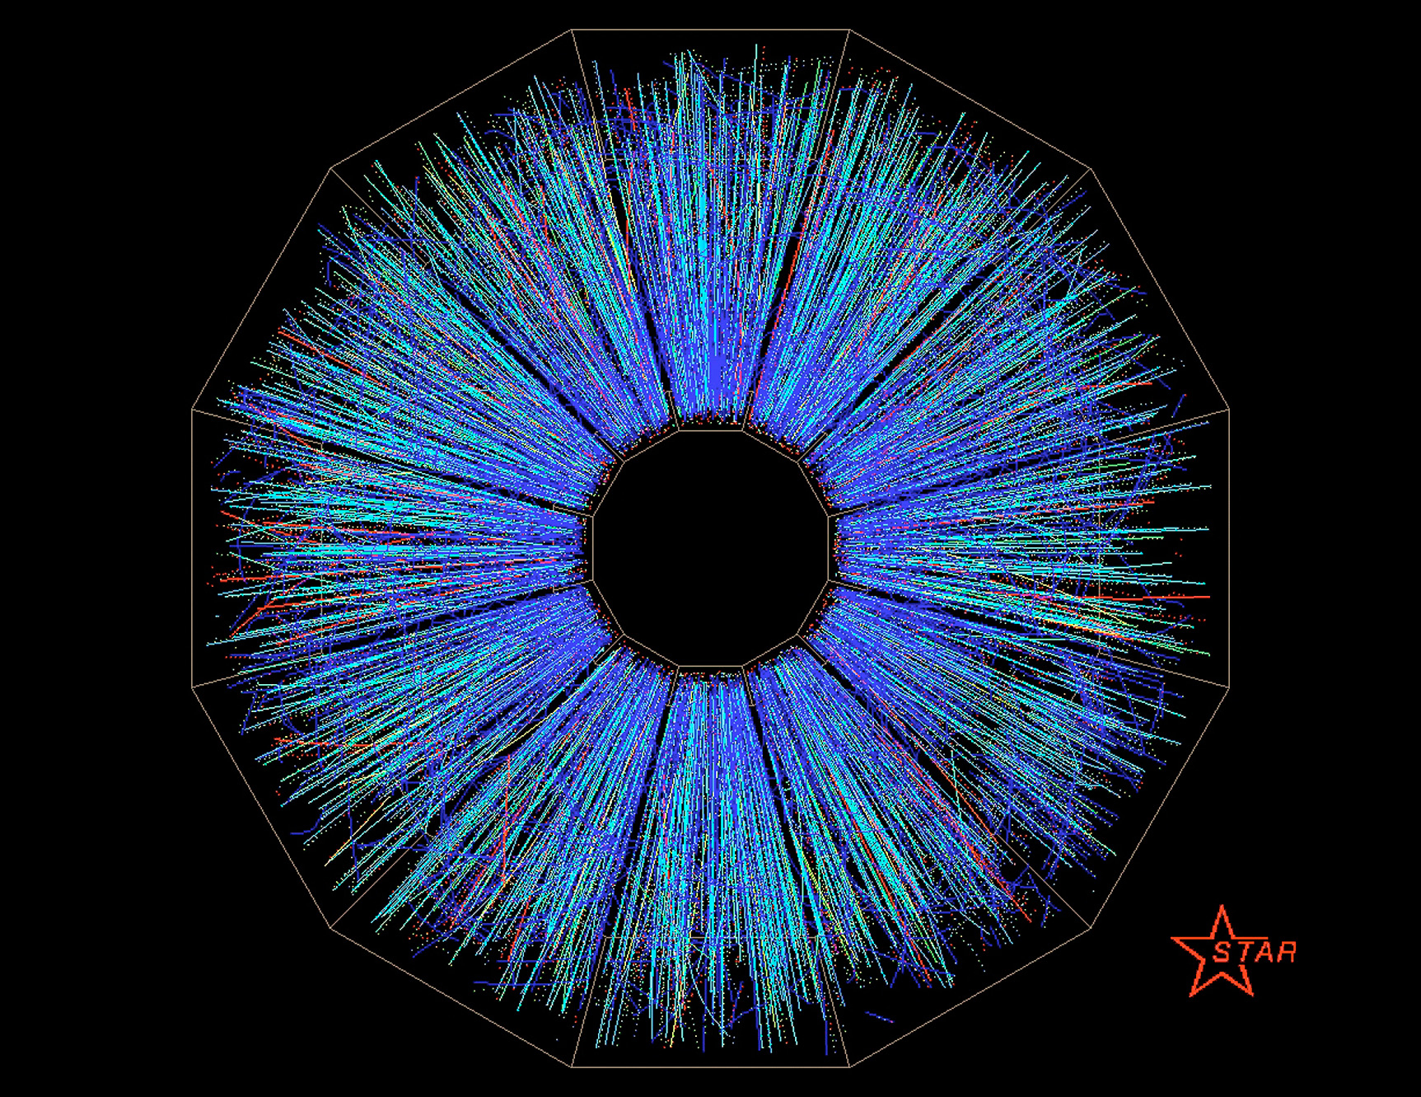
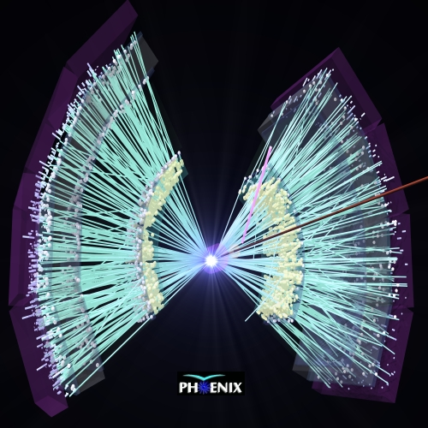
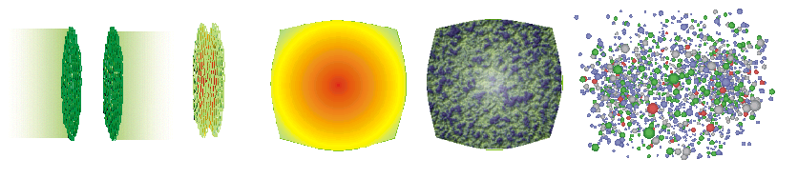
Standard model of heavy ion collisions
RV, ICHEP plenary, arXiv:1012.4699
Color Glass
Condensates
Initial
Singularity
Glasma
sQGP -
perfect fluid
Hadron
Gas
t

Slide 4
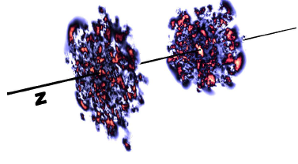
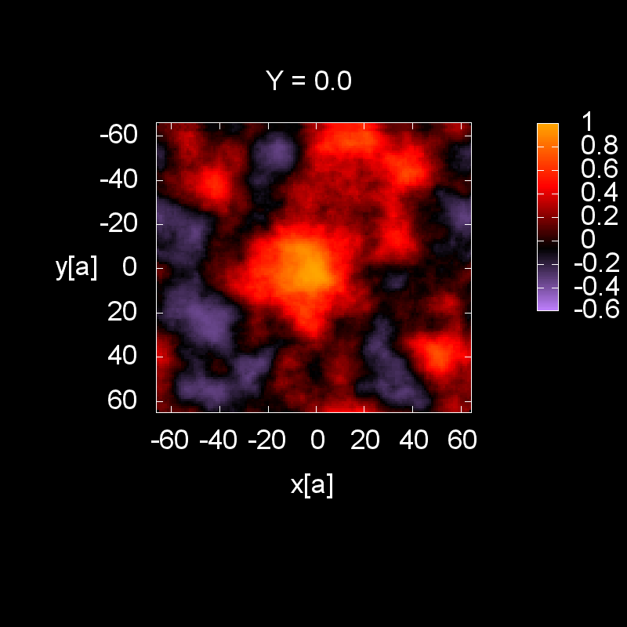
Multi-particle production: saturated wave-functions
Color charge fluctuations on
a length scale 1/Q_{S}
much smaller than proton size
Incoming nuclei are Color Glass Condensates: Highly occupied gluon states with maximal occupancy in QCD.
Idea ! high occupancy of gluons at small x (high energy) admits a classical EFT description
Computations in this framework becoming available at next-leading-log accuracy
McLerran, RV (1994)

Slide 5
Standard model of heavy ion collisions
Color Glass
Condensates
Initial
Singularity
Glasma
sQGP -
perfect fluid
Hadron
Gas
t

Slide 6
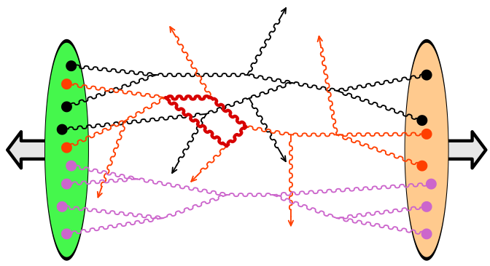
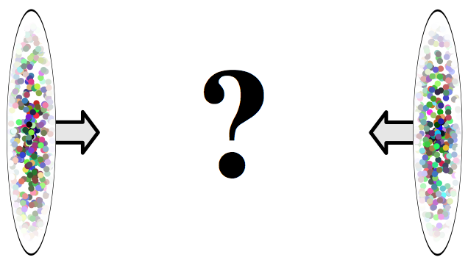
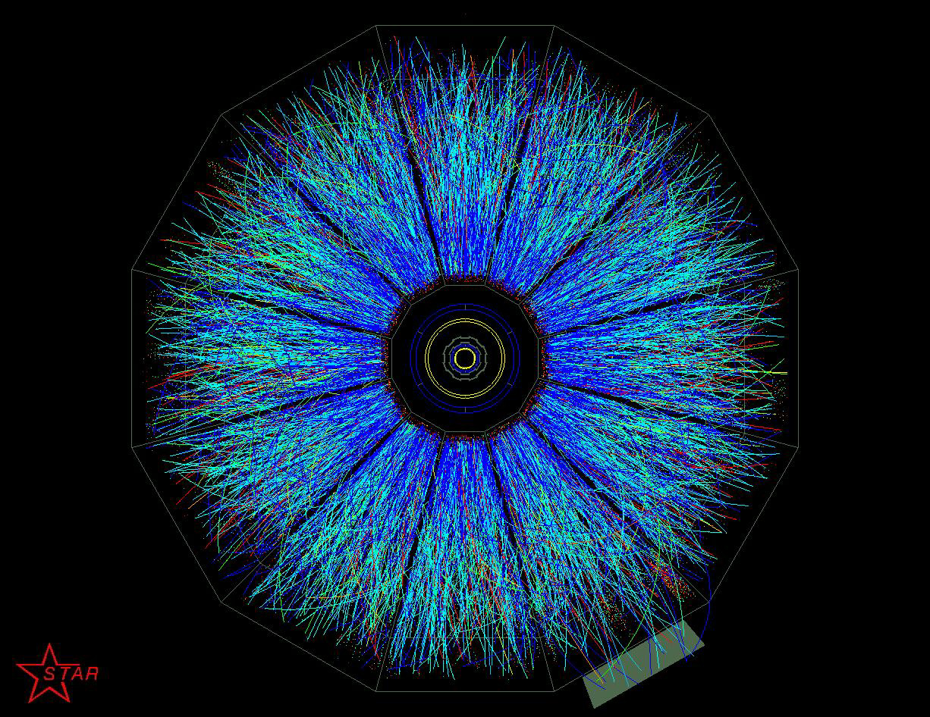
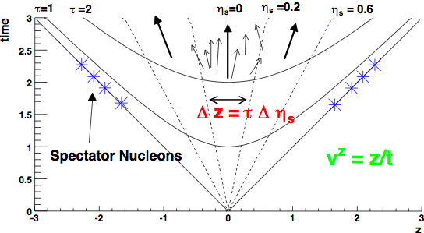
Forming a Glasma in the little Bang
Glasma (\Glahs-maa\): Noun: non-equilibrium matter between Color Glass Condensate (CGC)& Quark Gluon Plasma (QGP)

Slide 7
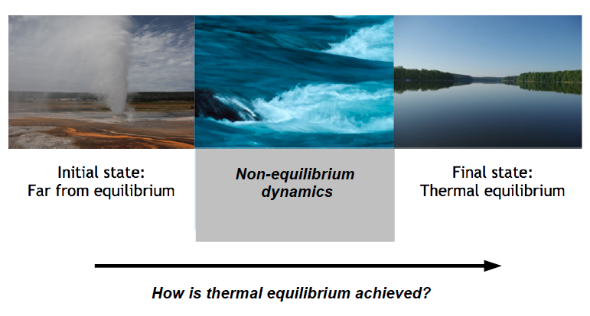
From the violence of a nuclear collision
…to the calm of a quark-gluon fluid

Slide 8
Approaches to thermalization
Two ``clean” theoretical limits:
Holographic thermalization (based on duality of strongly coupled
(g² N_{c} ➔∞; N_{c} ➔ ∞)
N=4 SUSY YM to classical gravity in AdS₅×S₅ )
Highly occupied QCD at weak coupling
( g² ➔ 0 ; g² f ~ 1)
Our focus: non-equilibrium strongly correlated gluodynamics
at weak coupling

Slide 9
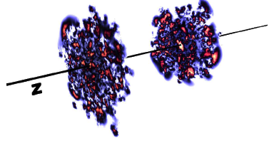
Heavy ion phenomenology in weak coupling
Collisions of lumpy gluon ``shock” waves
Leading order solution: Solution of QCD Yang-Mills eqns
Krasnitz, RV (1999)
Lappi (2003)

Slide 10
Heavy ion phenomenology in weak coupling
Collisions of lumpy gluon ``shock” waves
Leading order solution: Solution of QCD Yang-Mills eqns
Q_{S} (x,b_{T}) determined from saturation model fits to HERA
inclusive and diffractive DIS data

Slide 11
Heavy ion phenomenology in weak coupling
Leading order Yang-Mills solutions are boost invariant:
valence partons
Energy dist. of YM fields

Slide 12
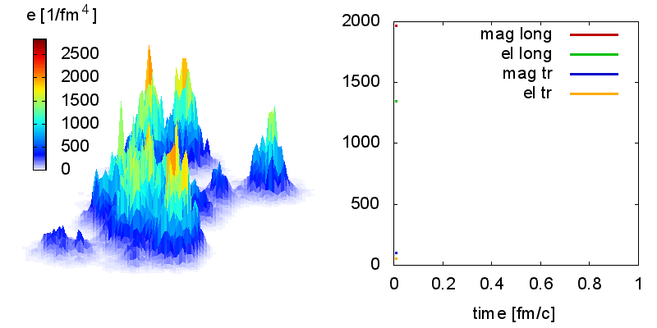

Matching boost invariant Yang-Mills to hydrodynamics
Glasma energy density and pressure
Initial longitudinal pressure is negative:
Goes to P_{L} =0 from below with time evolution

Slide 13
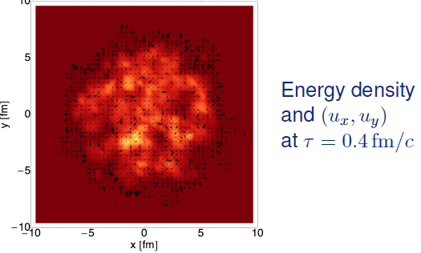

Matching boost invariant Yang-Mills to hydrodynamics
Energy density and (u_{x},u_{y}) from

Slide 14
Matching boost invariant Yang-Mills to hydrodynamics
Matching to viscous hydro is “brutal” : assume “instantaneous” isotropization
The heart of the matter:how does isotropization/thermalization occur in ~ 1 fm/c ?

Slide 15
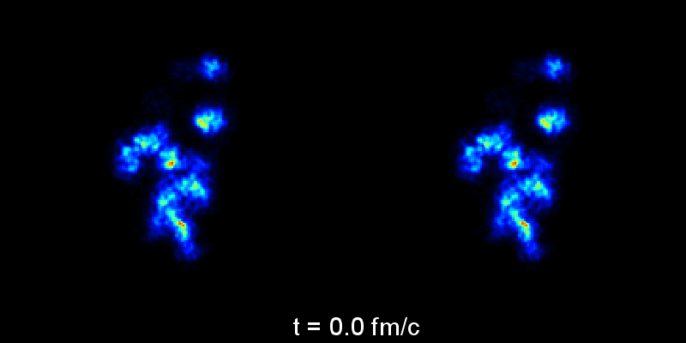
Heavy ion phenomenology in weak coupling
State of the art phenomenology: Solve relativistic viscous hydrodynamic equations with Glasma (Yang-Mills) initial conditions
Match event by event Glasma (YM)+2+1-D viscous hydro
Energy dist. of YM fields
YM+hydro
Schenke,Tribedy,RV, PRL 108 (2012) 252301, PRC 86 (2012) 034908
Gale, Jeon, Schenke, Tribedy, RV, PRL 110 (2013) 1, 012302

Slide 16
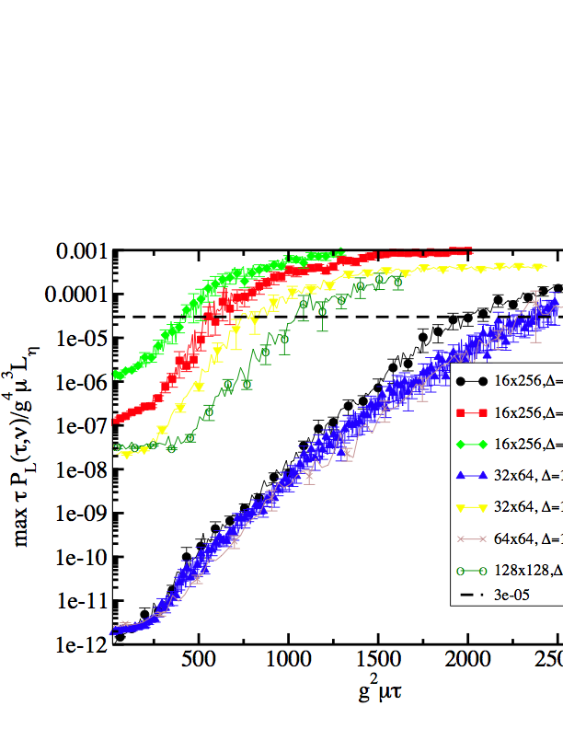

The Glasma at NLO: plasma instabilities
Romatschke,Venugopalan
Dusling,Gelis,Venugopalan
Gelis, Epelbaum
At LO: boost invariant gauge fields A_{cl}^{μ,a}(x_{T},τ) ~ 1/g
NLO: A^{μ,a} (xT,τ,η) = A_{cl}^{μ,a}(x_{T},τ) + a^{μ,a}(η)
a^{μ,a}(η)= O(1)
Small fluctuations grow
exponentially as ~
increasing
seed size
2500
Q_{S}τ

Slide 17
The Glasma at NLO: plasma instabilities
Romatschke,Venugopalan
Dusling,Gelis,Venugopalan
Gelis, Epelbaum
At LO: boost invariant gauge fields A_{cl}^{μ,a}(x_{T},τ) ~ 1/g
NLO: A^{μ,a} (xT,τ,η) = A_{cl}^{μ,a}(x_{T},τ) + a^{μ,a}(η)
a^{μ,a}(η)= O(1)
Small fluctuations are same order of classical field at
increasing
seed size
Resum such contributions to
all orders
2500
Q_{S}τ

Slide 18
The Glasma at NLO: plasma instabilities
Romatschke,Venugopalan
Dusling,Gelis,Venugopalan
Gelis, Epelbaum
At LO: boost invariant gauge fields A_{cl}^{μ,a}(x_{T},τ) ~ 1/g
NLO: A^{μ,a} (xT,τ,η) = A_{cl}^{μ,a}(x_{T},τ) + a^{μ,a}(η)
a^{μ,a}(η)= O(1)
Small fluctuations grow
exponentially as ~
Same order of classical field at
increasing
seed size
Resum such contributions to
all orders
Q_{S}τ
2500
Leading quantum corrections can be expressed as average over
a classical-statistical ensemble of initial conditions

Slide 19
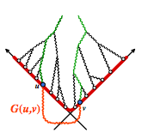
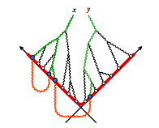
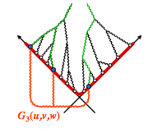
Spectrum of initial quantum fluctuations
Dusling,Gelis,RV (2011)
Gelis, Epelbaum (2013)
Higher orders:
These are “parametrically suppressed” - just barely…

Slide 20
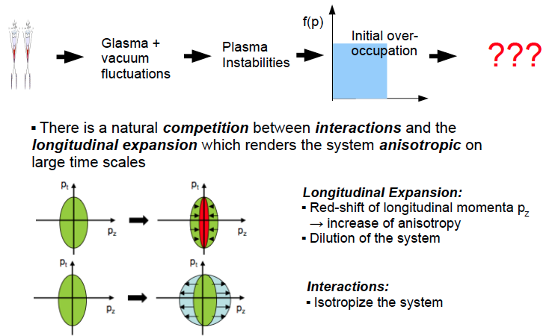
Initial conditions in the Glasma

Slide 21
Initial conditions in the Glasma

Slide 22



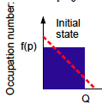
Initial conditions in the overpopulated QGP
Choose for the initial classical-statistic ensemble of gauge fields
Stochastic random
variables
Polarization vectors ξ expressed in terms of Hankel functions in Fock-Schwinger gauge A^{τ} =0
Controls “prolateness” or “oblateness” of initial
momentum distribution

Slide 23
Initial conditions in the overpopulated QGP
Overpopulation occurs even starting from the “first principles CGC”
initial conditions of Gelis & Epelbaum
-- where one starts with a background
Glasma field and computes the small fluctuations around it at τ=0+
Berges,Schenke,Schlichting,RV, NPA 931 (2014) 348

Slide 24
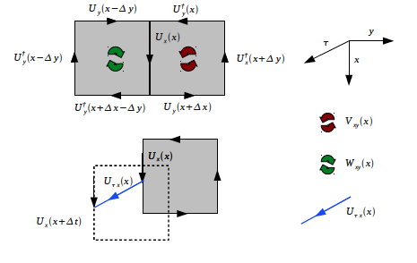
Temporal evolution in the overpopulated QGP
Berges,Boguslavski,Schlichting,Venugopalan
arXiv: 1303.5650, 1311.3005
Solve Hamilton’s equation for 3+1-D SU(2) gauge theory
in Fock-Schwinger gauge
Fix residual gauge freedom
imposing Coloumb gauge at
each readout time
Largest classical-statistical numerical simulations of
expanding Yang-Mills to date: 256² × 4096 lattices

Slide 25
Temporal evolution in the overpopulated QGP
Berges,Boguslavski,Schlichting,Venugopalan
arXiv: 1303.5650, 1311.3005
Solve Hamilton’s equation for 3+1-D SU(2) gauge theory
in Fock-Schwinger gauge
Fix residual gauge freedom
imposing Coloumb gauge at
each readout time
Classical-statistical computations performed at weak coupling…
α_{S}=10⁻⁵ for “classical dominance” at all times in simulation:
-- corresponds to Qτ₀ ≈ Ln²(1/α_{S}) ≈ 100

Slide 26
Pressure becomes increasingly anisotropic
P_{L}/P_{T} approaches universal τ^{-2/3} behavior

Slide 27



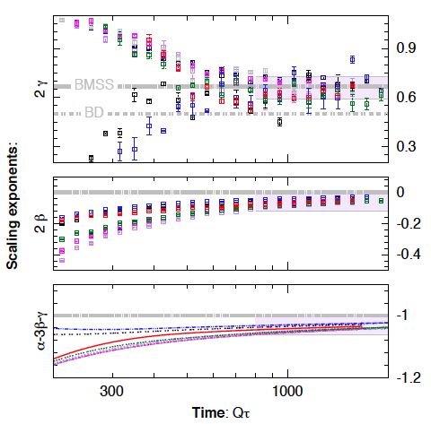
Hard scales show universal scaling
Gauge invariant quantities:
simple quasi-particle
interpretation for weak fields
Kurkela,Moore (2012)
β = 0 suggests no shift of hard transverse
momentum scale in time
γ = 1/3 system longitudinal hard scale
red-shifts but slower than
free streaming value of γ=1

Slide 28
Kinetic theory in the overoccupied regime
For 1 < f < 1/α_{S} a dual description is feasible either in terms of
kinetic theory or classical-statistical dynamics …
Mueller,Son (2002)
Jeon (2005)
Different scenarios:
Elastic multiple scattering dominates in the Glasma
Rescattering influenced by plasma (Weibel) instabilities
Transient Bose condensation+multiple scattering
BMSS: Baier,Mueller,Schiff,Son
DB: Bodeker
KM: Kurkela, Moore
BGLMV: Blaizot,Gelis,Liao,McLerran,Venugopalan

Slide 29
Kinetic theory in the overoccupied regime
For 1 < f < 1/α_{S} a dual description is feasible either in terms of
kinetic theory or classical-statistical dynamics …
Mueller,Son (2002)
Jeon (2005)
Different scenarios:
Q
m_{Debye}
Q
Differences arise due to assumptions of non-perturbative behavior
at p≈m_{Debye}

Slide 30
Result: universal non-thermal fixed point
Conjecture:
Moments of distribution extracted over range of time slices
lie on universal curves
Distribution as function of p_{T} displays 2-D thermal behavior

Slide 31




Kinetic interpretation of self-similar behavior
Follow wave turbulence kinetic picture of Zakharov, as developed by Micha & Tkachev in context of inflation
Fixed point solution satisfies
μ=α-1
If we assume that small angle elastic scattering dominates

Slide 32
Kinetic interpretation of self-similar behavior
For self-similar scaling solution, a) small angle elastic scattering
b) energy conservation
c) number conservation
Give unique results: α = -2/3, β = 0 , γ = 1/3
These are the same exponents (within errors) extracted from
our numerical simulations !
The same exponents appear in the “bottom-up” thermalization
scenario of Baier, Mueller, Schiff, Son (BMSS)

Slide 33
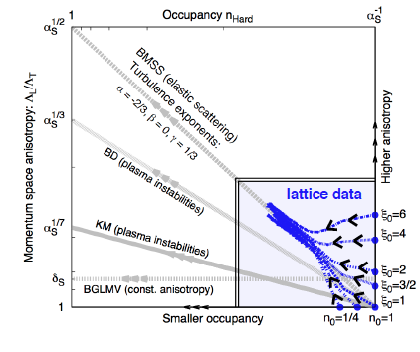
Non-thermal fixed point in overpopulated QGP
Berges,Boguslavski,Schlichting,Venugopalan. arXiv: 1303.5650
BMSS: Baier,Mueller,Schiff,Son
BD: Bodeker
KM: Kurkela, Moore
BGLMV: Blaizot,Gelis,Liao,McLerran,Venugopalan

Slide 34
Universal non-thermal attractor in QCD
“Big whorls have little whorls, which feed on their velocity, And little whorls have lesser whorls, and so on to viscosity.”

Slide 35
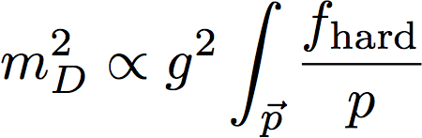

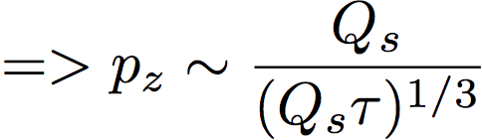
Quo vadis, thermal QGP?
The “bottom-up” scenario:
Q_{S}
Baier,Mueller,Schiff,Son
Scale for scattering of produced gluons
(t > 1/Q_{S}) set by
m_{D}
Q_{S}
Build up p_{z} (which fights the red shift of p_{z} ~ 1/t) with mult. scattering
Our simulations support this picture
– no significant role of instabilities -- imaginary component in m_{D}
(conjectured by Arnold, Moore, Lenaghan and Yaffe to spoil the bottom up scenario)

Slide 36
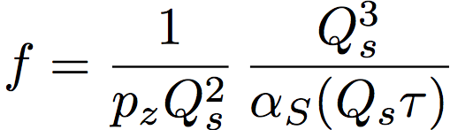
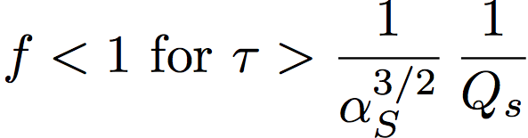
Quo vadis, thermal QGP?
Occupation #
Q_{S}
m_{D}
Classical statistical simulations break down
in this regime
Q_{S}
In quantum regime, thermalization proceeds through
number changing inelastic processes
Thermalized soft bath of gluons for
Thermalization temperature of

Slide 37
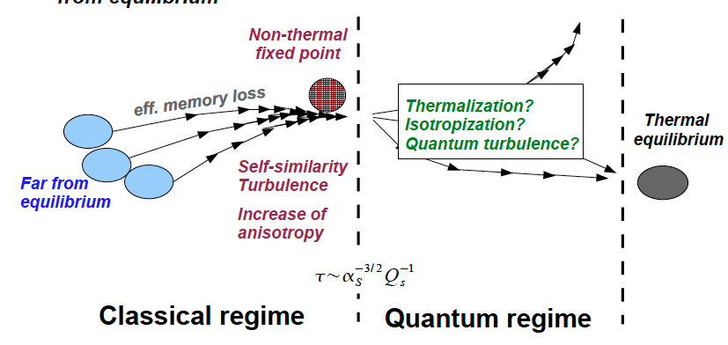
Quo vadis, thermal QGP?

Slide 38
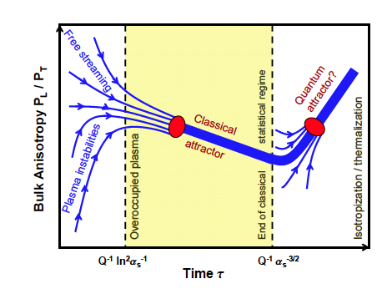
Quo vadis, thermal QGP?
Blaizot,Dominguez,
Iancu,Mehtar-Tani

Slide 39
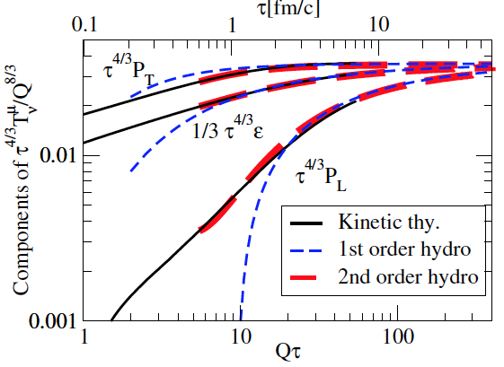
Matching to hydrodynamics
Kurkela, Zhu, 1506.06647
α_{S}=0.3
Good matching of quantitative implementation of BMSS to
hydrodynamics at times ~ 1 fm for extrapolations to realistic couplings

Slide 40
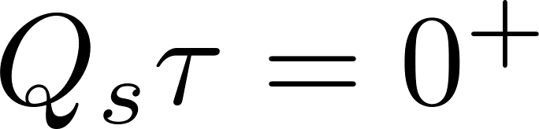
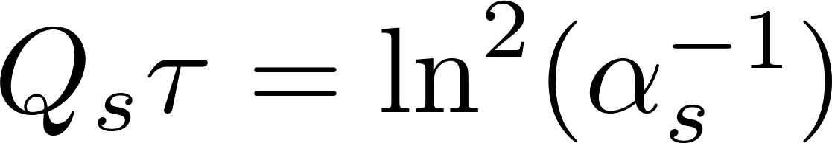
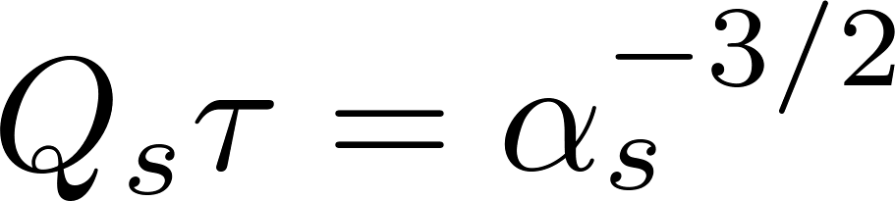
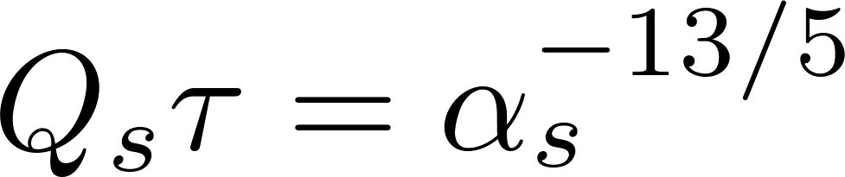
Glasma to Plasma: from nuts to soup
Boguslavski
Glasma;
Instabilities;
Classical NTFP;
Constant anisotropy,
Radiational breakup;
Hydrodynamics,
Thermalization
Good matching of quantitative implementation of BMSS to
hydrodynamics at times ~ 1 fm for extrapolations to realistic couplings

Slide 41
Universality: hotness is also cool

Slide 42
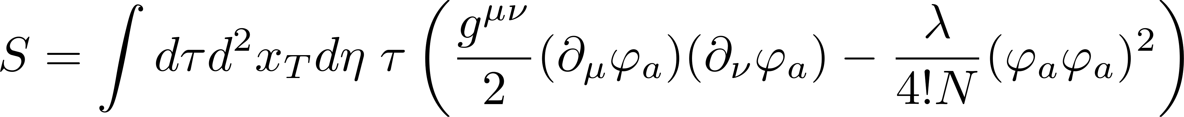
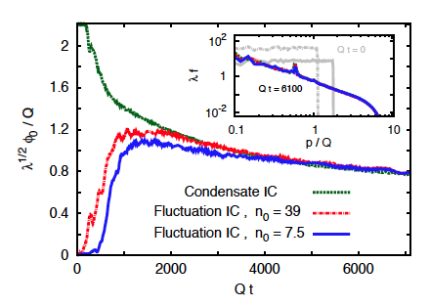
Over-occupied self-interacting scalars
In a non-relativistic limit, can be used to model cold atomic gases
Scheppach,Berges,Gasenzer, PRA 81 (2010) 033611
Nowak, Schole, Sexty, Gasenzer, PRA85 (2012) 043627
Nowak et al., arXiv 1302.1448
Real time evolution is independent
of initial conditions
Berges, Sexty PRL 108 (2012) 161601
Berges,Boguslavski,Orioli, PRD 92, 025041 (2015)
Berges,Boguslavskii,Schlichting,Venugopalan, JHEP 1405 (2014) 054

Slide 43
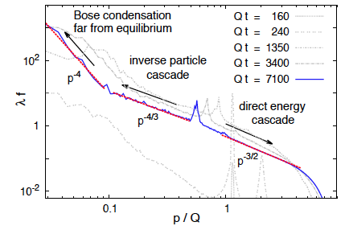
Over-occupied self-interacting scalars
Over-occupied scalars in a box:
Nontrivial universal dynamics including non-equilibrium formation of BEC
Good understanding of infrared dynamics in vertex resummed kinetic theory
using 2PI – 1/N methods to NLO
Berges, Sexty PRL 108 (2012) 161601
Berges,Boguslavski,Orioli, PRD 92, 025041 (2015)
Berges,Boguslavskii,Schlichting,Venugopalan, JHEP 1405 (2014) 054

Slide 44
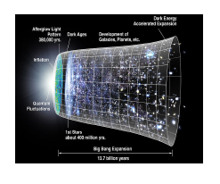
Early universe cosmology: turbulent thermalization
Micha,Tkachev, PRD 70 (2004) 043538
Model for early universe thermalization:
Weakly coupled scalar field theory (λΦ⁴) (λ=10⁻⁸ )
In homogeneous background field
+ vacuum fluctuations
Growth of instabilities via parametric resonance of classical field
and vacuum fluctuations

Slide 45
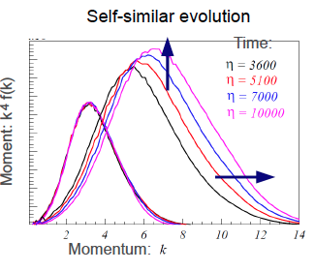
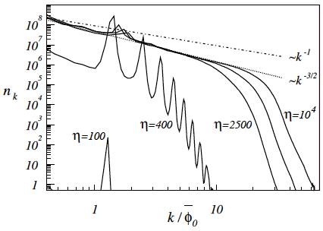
Turbulent thermalization in Cosmology
Micha,Tkachev, PRD 70 (2004)043538
n_{hard} ~ t^{α}
Λ ~ t^{-β}
Thermalization process characterized by quasi-stationary evolution with
scaling exponents.
Dynamic: α=-4/5, β=-1/5 ; Spectral: κ= -3/2

Slide 46
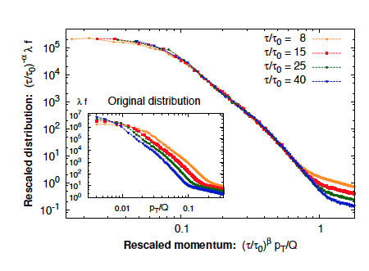
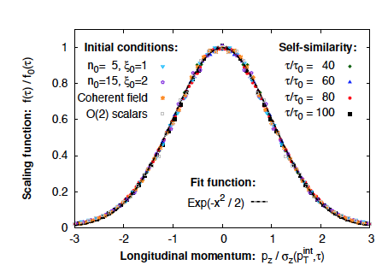
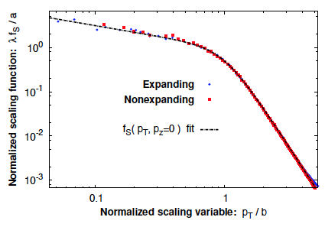
What about longitudinally expanding scalars?
Berges,Boguslavski,Schlichting,RV, 1508.03073, PRD in press
Three distinct inertial regimes
with self-similar behavior

Slide 47
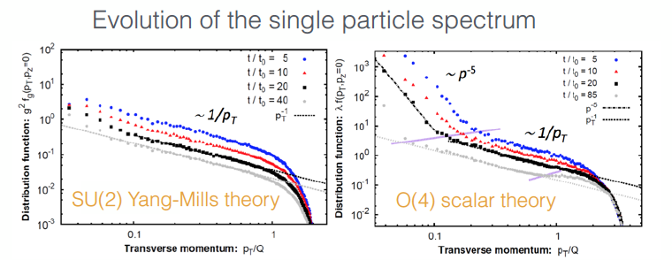
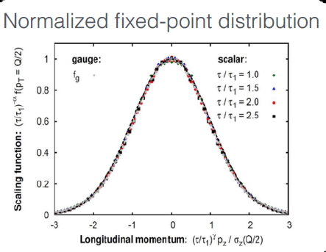
A remarkable universality
Leads to Bose-Einstein
condensation
Berges,Boguslavski,Schenke,Venugopalan,
PRL 114 (2015) 061601, Editor’s suggestion
In a wide inertial range, scalars and gauge
fields have identical scaling exponents
and scaling functions
Very surprising from a kinetic theory
perspective

Slide 48
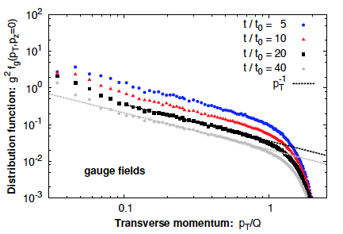
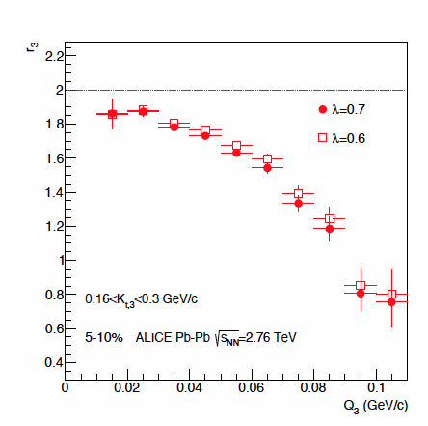
A remarkable universality
Can this provide insight into possible
transient BEC in heavy-ion collisions ?
Blaizot,Gelis,Liao,McLerran,RV NPA (2012)
Floerchinger,Wetterich, JHEP 1403 (2014) 121
Intriguing data from ALICE on
three pion Hanbury-Brown—Twiss (HBT)
correlations hint at possible condensate
fraction of 22 ± 12 %
ALICE, arXiv:1310.7808

Slide 49
Infrared dynamics in the gauge theory:
Sphaleron transitions off equilibrium

Slide 50
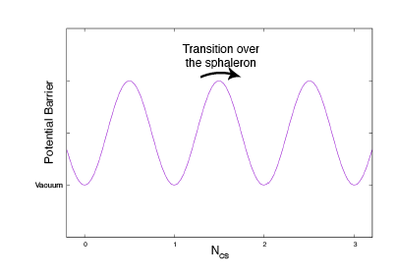
Sphaleron transitions
Most efficient way to generate topological transitions at finite temperature or energy density
For the Chiral Magnetic Effect, need these transitions to occur early – since the external magnetic field dies quickly

Slide 51
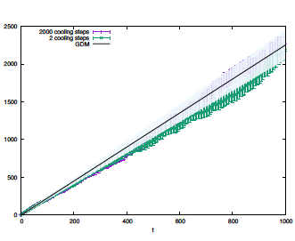
Sphaleron transitions in the QGP
Sphaleron transition rate
Check: Good agreement with results of G. Moore for the thermal case…

Slide 52

Topological charge dist.: thermal configurations
M. Mace, S. Schlichting, R. Venugopalan,
in preparation

Slide 53


Sphaleron transitions in the Glasma
M. Mace, S. Schlichting, R. Venugopalan
Very clear indication of topological transitions in the overoccupied Glasma
Note: results are for a fixed box

Slide 54

Sphaleron transitions in the Glasma
M. Mace, S. Schlichting, R. Venugopalan, preliminary
Clean separation of hard, electric (Debye) and magnetic (Spatial Wilson loop)
scales seen with time – essential for thermalization…

Slide 55


Sphaleron transitions in the Glasma
M. Mace, S. Schlichting, R. Venugopalan, preliminary
Sphaleron scattering rate appears to scale as (inverse magnetic length)⁴
Apples to apples comparisons to thermal rates, phenomenology, in progress…

Slide 56
Engineering the world’s smallest fluid?

Slide 57


Long-range rapidity correlations in p+p, p+A and A+A collisions
S.Schlichting, Quark Matter 2015
Multiplicity in event
Non-equilibrium
Equilibrium
Highly precise data on multiplicity triggered 2 & 4 particle correlations from RHIC and LHC
will test onset of hydrodynamic behavior within a system and across systems

Slide 58
Thanks for your attention !

Slide 59

Turbulent thermalization in Cosmology
Free Turbulence:
Quasi-stationary solution: universal, non-thermal spectral exponents
Self-similar evolution with universal dynamical scaling exponents

Slide 60
Back to the Glasma…

