Slide 1
Viscous hydrodynamics:
interplay of shear and bulk viscosity
Huichao Song
The Ohio State University
Supported by DOE
in collaboration with Ulrich Heinz
H. Song and U. Heinz arXive:0909.1549 [nucl-th]
Flow and Dissipation in ultra-Relativistic Heavy Ion Collisions
ECT, Trento, Italy; Sep 14-18, 2009
09/17/2009

Slide 2
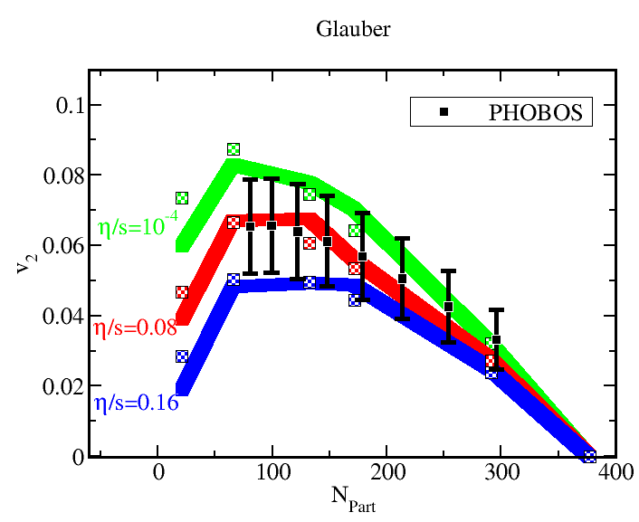
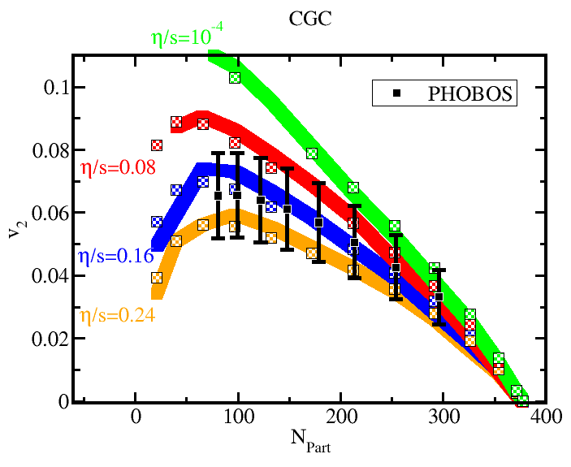
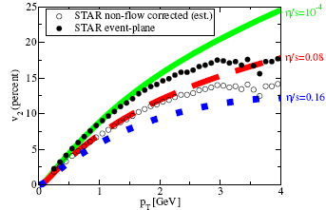
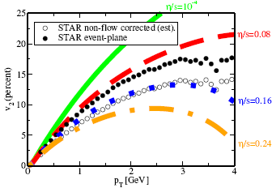
Glauber
Luzum & Romatschke, PRC 2008
CGC
-Glauber vs.CGC ~100% effect on the extracted value of
-A detailed extraction of shear viscosity entropy ratio also requires:
-viscous late hadronic stage
-non-equilibrium chemistry in HG
has been studied in ideal hydro
-bulk viscosity ?
-Present conservative upper limit:
5

Slide 3
Viscous hydro with shear & bulk viscosity
shear viscosity
bulk viscosity
Conservation laws:
Evolution equations for shear pressure tensor and bulk pressure
(2nd order shear-bulk -mixing term (Muronga, Rischke) not included.)

Slide 4
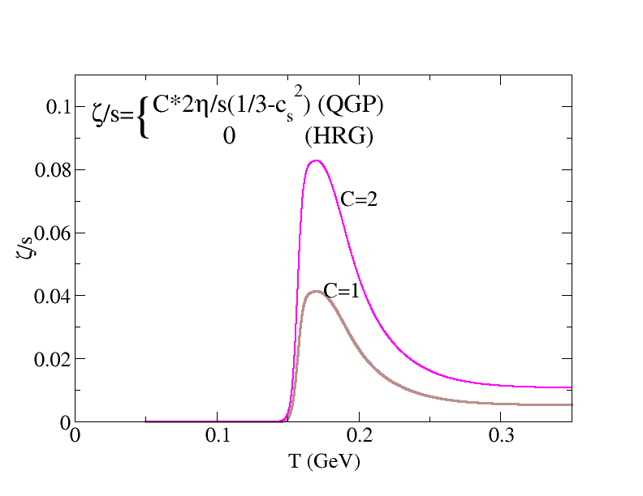
Numerical Results
Shear viscosity:
Bulk viscosity:
HRG
QGP
Min. AdS/CFT
prediction
Relaxation times: (see later)

Slide 5
Numerical Results
Bulk viscosity:
HRG
QGP
Min. AdS/CFT
prediction
(a) Change the flow profile during hydro evolution
bulk viscosity effects:
(b) Additional spectra correction along freeze-out surface
Relaxation times: (see later)
Song & Heinz:
v2 will decrease, flow corrections only (a), , at freeze-out
Monnai & Hirano:
v2 will increase, spectra corrections only(b), ideal hydro for evolution

Slide 6
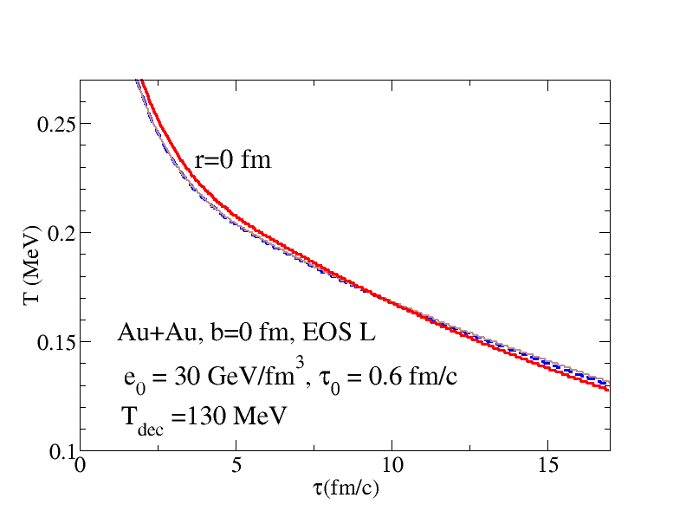
Shear viscosity vs. bulk viscosity (I)
Same initial & final conditions
ideal hydro viscous hydro-shear only viscous hydro-bulk only
Local temperature
-Shear viscosity: decelerate cooling process in early stage
accelerate cooling process in middle and late stages
-Bulk viscosity: decelerate cooling process

Slide 7
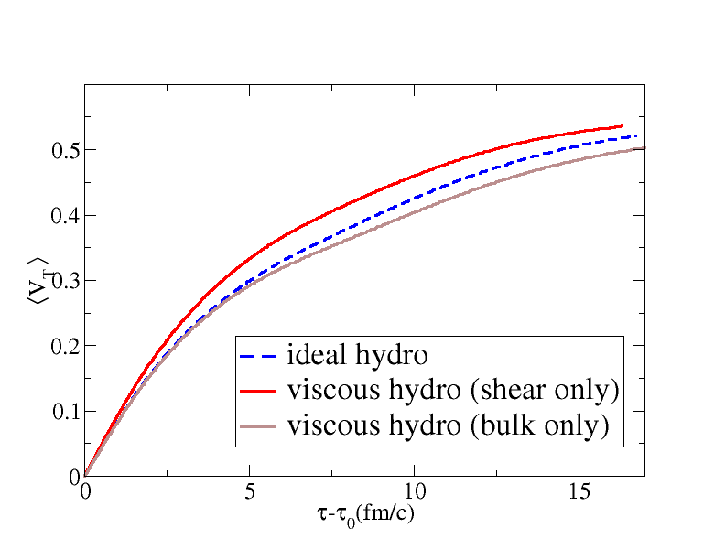
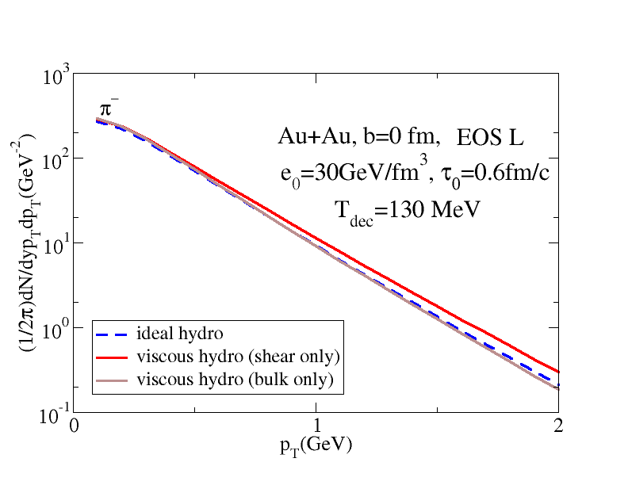
Shear viscosity vs. bulk viscosity (II)
Same Initial & final conditions
ideal hydro viscous hydro-shear only viscous hydro-bulk only
radial flow
spectra
-shear viscosity: increases radial flow, results in flatter spectra
-bulk viscosity: decreases radial flow, results in steeper spectra

Slide 8
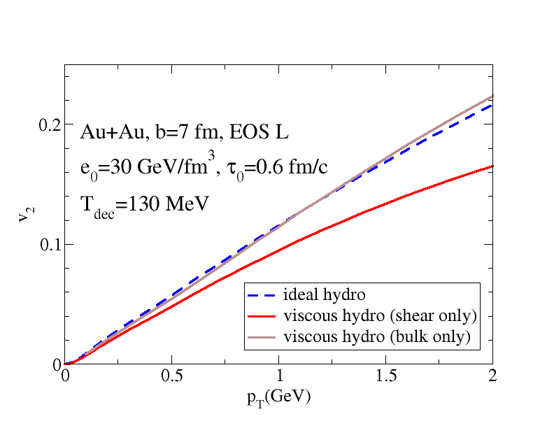
Shear viscosity vs. bulk viscosity (III)
Same Initial & final conditions
ideal hydro viscous hydro-shear only viscous hydro-bulk only
Elliptical flow v2
-v2 is sensitive to both shear and bulk viscosity

Slide 9
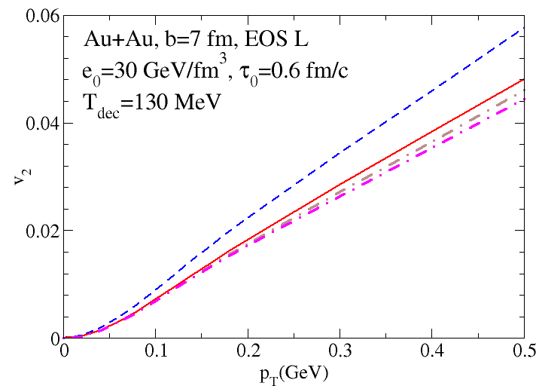
Viscous v2 suppression: shear and bulk viscosity
ideal hydro
visc. hydro:
30%
20%
-at RHIC, 2 x min. bulk viscosity could result in ~50% additional v₂ suppression
-when extracting the from RHIC data, bulk viscous effects cannot be neglected

Slide 10
Viscous v2 suppression: shear and bulk viscosity
ideal hydro
visc. hydro:
30%
20%
-at RHIC, 2 x min. bulk viscosity could result in ~50% additional v₂ suppression
-when extracting the from RHIC data, bulk viscous effects cannot be neglected
(a) Change the flow profile during hydro evolution
bulk viscosity effects:
(b) Additional spectra correction along freeze-out surface
Song & Heinz:
v2 will decrease, flow corrections only (a), , at freeze-out
Monnai & Hirano:
v2 will increase, spectra corrections only(b), ideal hydro for evolution

Slide 11
Bulk Viscosity
-relaxation time effects

Slide 12
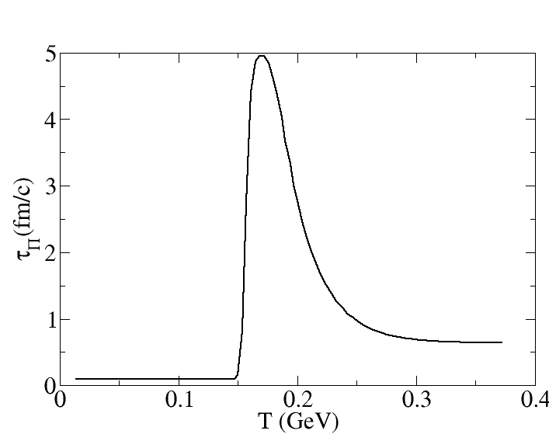
with critical slowing down
~5 fm/c
~0.5 fm/c

Slide 13
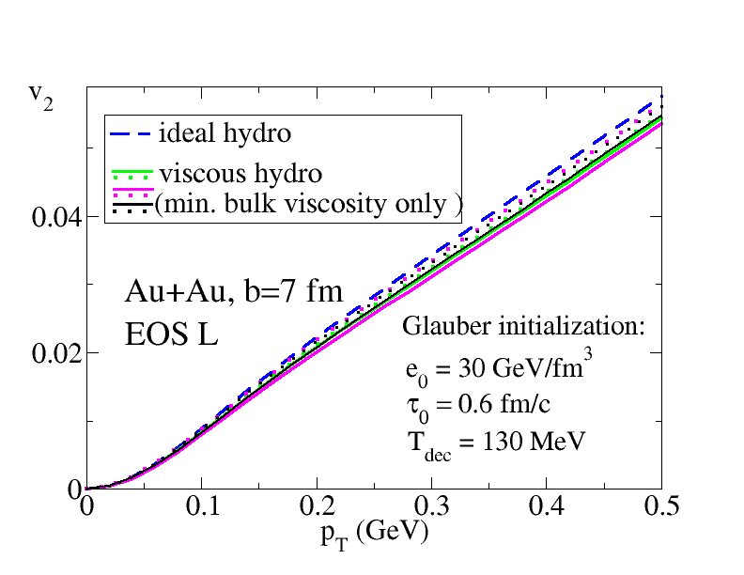
Bulk viscous v2 suppression:
-- relaxation time and initialization for
-viscous effects from bulk viscosity strongly depend on relaxation time and the initialization for bulk pressure

Slide 14
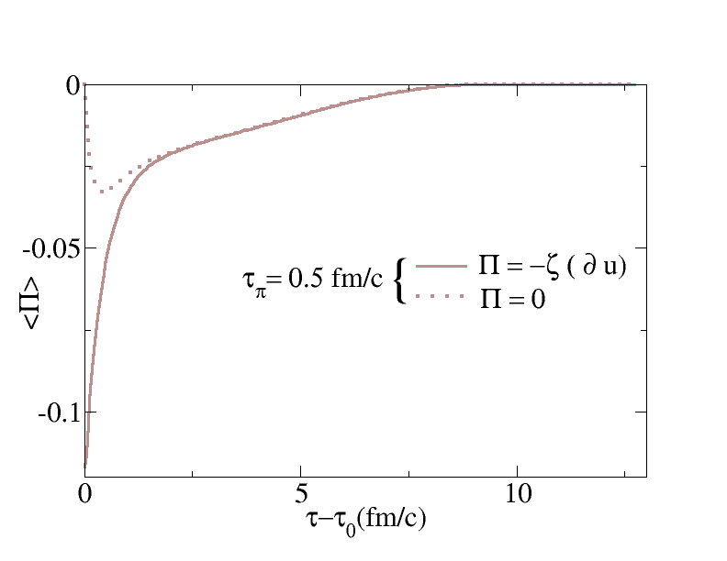
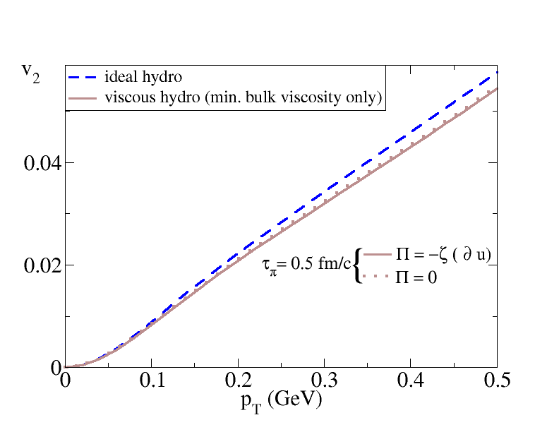
relaxation time and initialization for (I)
Smaller relaxation time
-When is small ,
is insensitive to different initializations of
-after (several relaxation times), viscous pressure loses memory of initial cond.

Slide 15
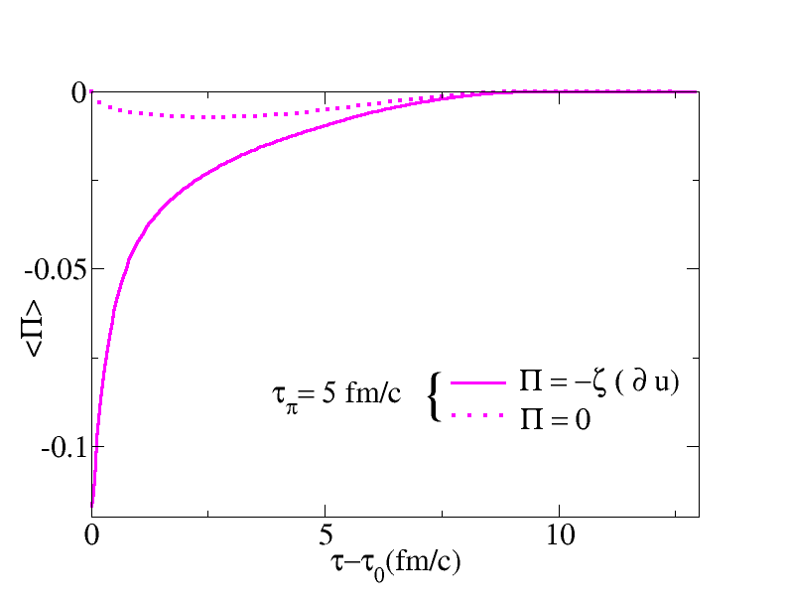
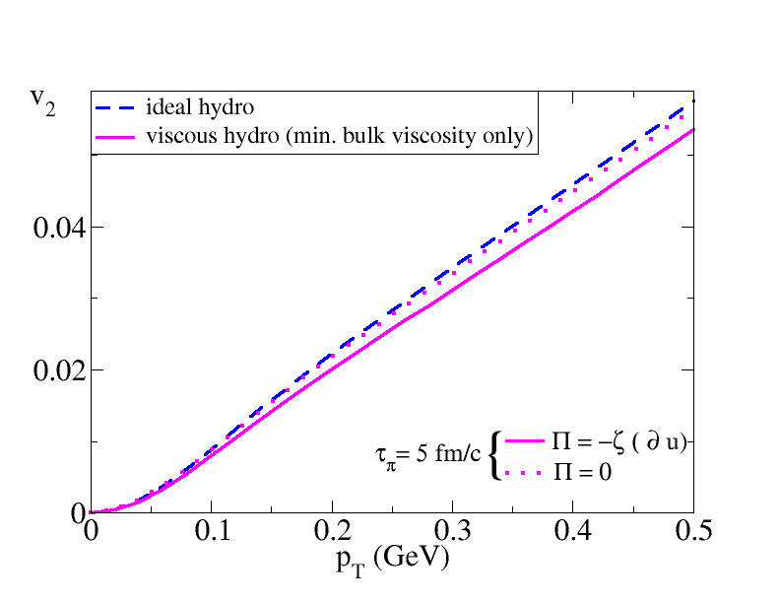
relaxation time and initialization for (II)
larger relaxation time
-When is larger ,
is sensitive to different initializations of
-after (several relaxation times), viscous pressure loses memory of initial cond.

Slide 16
relaxation time and initialization for (III)
relaxation time with critical slowing down
-for critical slowing down
is sensitive to different initializations of
-after (several relaxation times), viscous pressure loses memory of initial cond.

Slide 17
relaxation time and initialization for
-viscous effects from bulk viscosity strongly depend on relaxation time and the initialization for bulk pressure

Slide 18
Validity of viscous hydro
and upper limits of

Slide 19
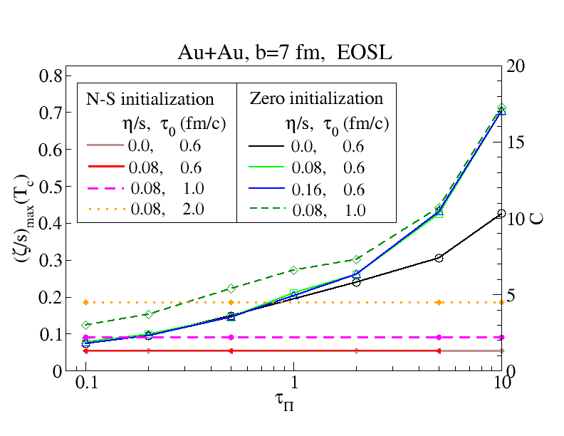
(Practical) upper limits of
-how does the upper limits of change with bulk relaxation time , bulk pressure initialization, shear viscosity and starting time ?

Slide 20
(Practical) upper limits of
HRG
QGP
Min. AdS/CFT
prediction

Slide 21
(Practical) upper limits of
-how does the upper limits of change with bulk relaxation time , bulk pressure initialization, shear viscosity and starting time ?

Slide 22
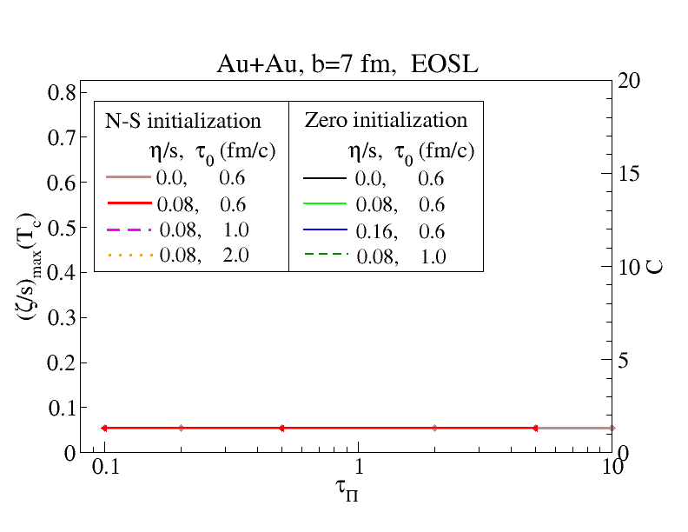
(Practical) upper limits of
N-S initialization
-for N-S initialization is insensitive to bulk relaxation time and shear viscosity.

Slide 23
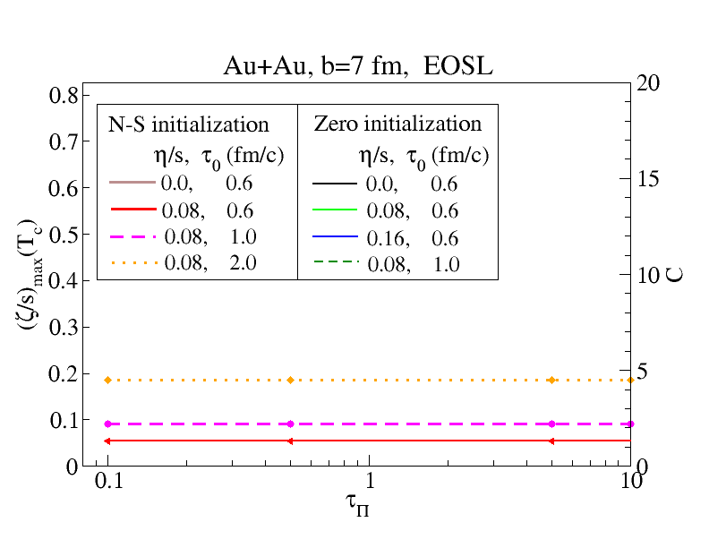
(Practical) upper limits of
N-S initialization
- increases with the increasing of starting time

Slide 24
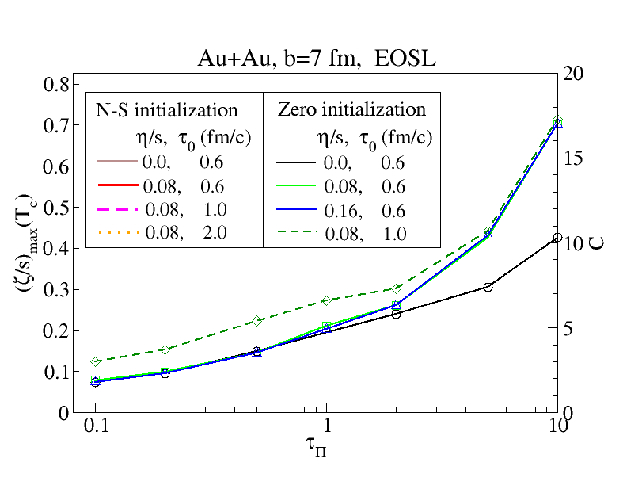
(Practical) upper limits of
zero initial.
-for zero initialization increases with bulk relaxation time

Slide 25
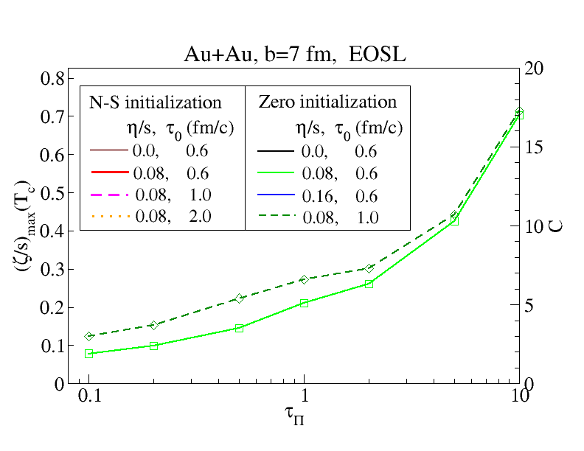
(Practical) upper limits of
zero initial.
- increases with the increasing of starting time

Slide 26
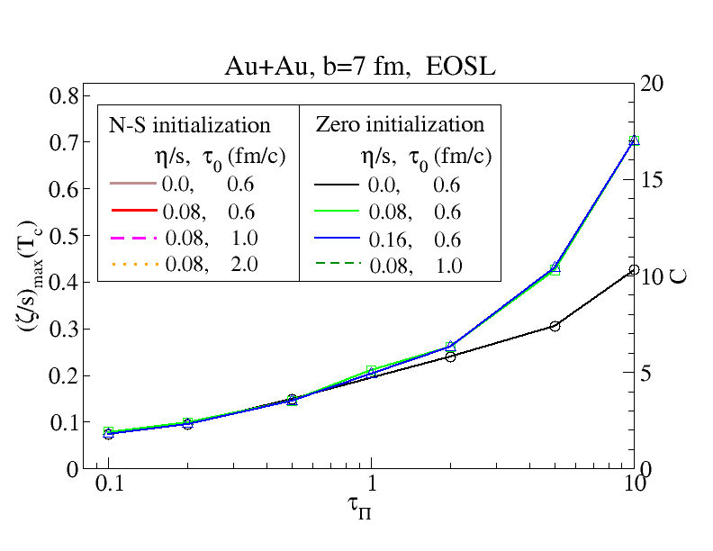
(Practical) upper limits of
zero initial.

Slide 27
(Practical) upper limits of
zero initial.
- For , universal curves, insensitive to shear viscosity

Slide 28
(Practical) upper limits of
zero initial.
Viscous
Ideal
- For , universal curves, insensitive to shear viscosity
- For , separation between ideal and viscous hydro

Slide 29
(Practical) upper limits of
- is sensitive to initialization of and starting time
-for N-S initialization:
-for zero initialization:
(for larger relaxation time)

Slide 30
(Practical) upper limits of
with critical slowing down
~5 fm/c
HRG
QGP
~0.5 fm/c
HRG
QGP
*
Bulk relaxation time with critical slowing down
*
-for N-S initialization:
-for zero initialization:
no upper limits for

Slide 31
Extracting from exp. data:
uncertainties from bulk viscosity

Slide 32
Uncertainties from bulk viscosity
N-S initialization
Zero initialization
-for N-S initialization: uncertainties from bulk viscosity to the extracted value of is around 15-20%
-for zero initialization: uncertainties from bulk viscosity can reach ~50%

Slide 33
Uncertainties from bulk viscosity
with critical slowing down
~5 fm/c
N-S initialization
Zero initialization
HRG
QGP
~0.5 fm/c
Bulk relaxation time with critical slowing down
-uncertainties from bulk viscous ~20% (N-S initial.) <15% (zero initial.)

Slide 34
Uncertainties from bulk viscosity
N-S initialization
Zero initialization
Bulk relaxation time with critical slowing down
-uncertainties from bulk viscous ~20% (N-S initial.) <15% (zero initial.)

Slide 35
A Short Summary
-When extracting QGP viscosity from experimental data, bulk viscosity effects could not be neglected
-Uncertainties from bulk viscosity (within the validity of viscous hydro )
-safely: <50% (for all conditions studied here)
-more physically: <20% (for critical slowing down)

Slide 36
Thank You

Slide 37
EOS
EOS

Slide 38
Viscous hydro in 2+1-dimension
Bjorken approximation:
coordinates
3+1 2+1
--the transport equations for energy momentum tensor are explicit written as:
-shear tensor decelerate longitudinal expansion, but accelerate transverse expansion
-bulk pressure decelerates both longitudinal & transverse expansion (bulk pressure effectively softens the EoS near the QCD phase transition)

Slide 39
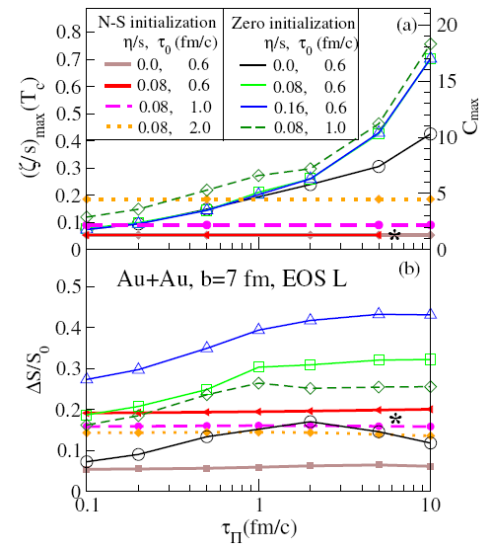
Entropy Production

